Slide 1
Performance Management for Supervisors and Staff
November 2022

Slide 2
Performance Management “Refresher”
Key Components of our time together today
Refresh on Macalester’s Performance Management Framework
Review the 3 Steps of Performance Management and specific action steps
Giving and Getting Feedback
“Catch All”
Next Steps

Slide 3
The Importance of Performance Management
Macalester’s Performance Management Framework is a collaborative process between the supervisor and employee, generally begins in August of each year, culminating annually at the end of July.
The framework is designed to ensure that:
Expectations are clear, resulting in strong performance, growth and results;
Better information is available to understand strengths and areas of opportunities for employees; and
Allow for continuous conversations, coaching and support throughout the performance calendar year.
The goals of performance management are to:
Align supervisors and employees to job responsibilities and expectations;
Enhance the supervisor and team/employee collaboration;
Develop employee capabilities through effective, timely feedback;and
Improve communication and relationship between employees and supervisors.
STEP ONE: GOAL SETTING
STEP THREE: YEAR-END PERFORMANCE REVIEW
ONGOING FEEDBACK
ONGOING FEEDBACK
STEP TWO: MID-CYCLE CHECK-IN

Slide 4
Performance Management Framework
STEP ONE:
Define focus & growth goals for
Performance year
(August - September)
STEP TWO:
Formal mid-cycle check-in
**(February)
STEP THREE:
Performance Evaluation
Recap of Year
(June - July)
ONGOING FEEDBACK ONGOING FEEDBACK ONGOING FEEDBACK ONGOING FEEDBACK ONGOING FEEDBACK
** denotes change from prior year

Slide 5
Goal Setting
At the beginning of the performance management cycle, it is important for supervisors to work with employees to establish performance expectations, and develop SMART goals for the performance year. These goals should outline the expected performance AND result.
SMART goals aid in the development of individual plans and tasks as well as provide the framework for performance feedback and coaching conversations.
SMART Goals are:
Questions to ask:
Specific | Goals are straightforward in their description. Describes exactly what needs to be accomplished.
Measurable | Goals have concrete, objective criteria that determine if and when a goal is met. Pre-defined measures help keep the employee on track toward reaching the goal.
Ambitious but Attainable | Goals are considered a stretch, but realistic, and can be accomplished within the specified timeframe, with the available resources.
Results-Oriented | Goals focus on the intended results.
Timebound | Goals have specific target date that must be met.
Specific | Be specific. What am I going to do? What do I want to accomplish? How am I going to do it?
Measurable | Build-in ways to measure progress. How will I know when I’ve reached my goal? How will I measure my progress?
Ambitious but Attainable | Stretch yourself. Does this goal stretch my knowledge and/or skillset? Can I realistically accomplish this goal?
Results-Oriented | Does the goal relate to what I want to accomplish in my role, or for the department?
Timebound | Commit to a target date. Will I accomplish my goal next month, next semester, by end of July?

Slide 6
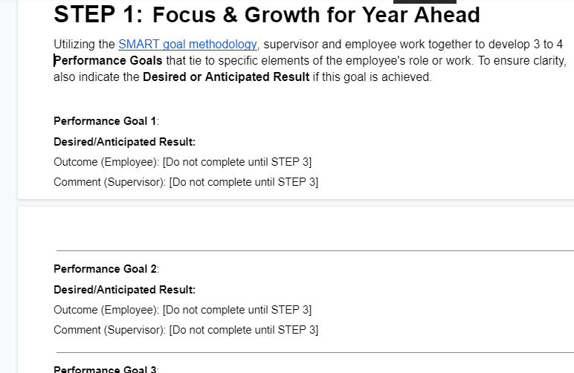
Step 1 in action
Key Actions:
- Share any Department or Team goals for this academic year with your team.
- Download Staff Review template from Mac Google Drive, and share with your direct report(s).
- Schedule 1:1s to collaborate and finalize performance and development goals, and desired results for the academic year.
- Finalize goals by November 18.
- Schedule regularly occurring 1:1 meetings throughout the year.

Slide 7
Mid-cycle Check-in
The mid-cycle check-in is considered Step Two in Macalester’s Performance Management Framework, occurring in or around February of the performance calendar.
The check-in is an intentional discussion, focused on an open and honest, two-way conversation on the work performance to this point.
(Possible) Agenda for discussion:
Progress on identified goals. Are they still appropriate? Did anything change?
Discuss overall performance to date. Balanced conversation.
Identify barriers and/or opportunities at the midpoint of the cycle.
Promote collaborative focus on individual and department success.
Open discussion to any additional support may be needed to ensure success.
(Possible) Prompts for discussion:
What’s working well? What could be better?
Are you experiencing any obstacles to achieving your goals?
What thoughts do you have for helping us be even better at what we are trying to do this year?
Anything we need from each other?
Who should be recognized for their work and/or support in helping you be successful? A specific person? A department?

Slide 8
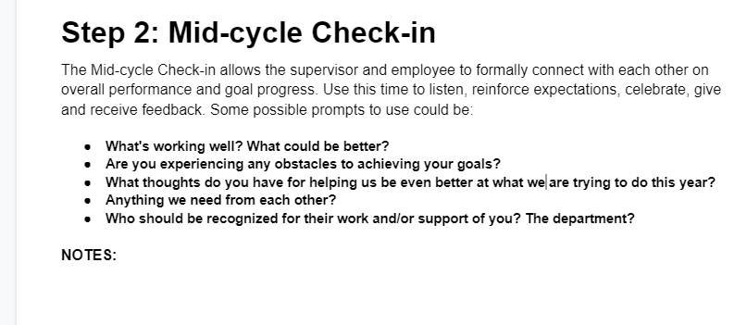
Step 2 in action
Key Actions:
- Schedule dedicated time for this discussion in or around February.
- Prior to the meeting both supervisor and employee should revisit performance and development goals and prepare for an interactive conversation.
- Supervisor should reach out to Employment Services if coaching is needed.
- Ensure a balanced conversation; both talking/listening and content.
- Continue with regularly occurring 1:1 meetings throughout the year.

Slide 9
Year-end Performance Review
The Accomplishments & Recap of the Year is considered Step Three in Macalester’s Performance Management Framework, occurring in June and July of the performance calendar.
The performance review session is a recap of what occurred throughout the rating period. It also provides time for supervisors and employees to reflect on contributions, discuss SMART goals for the next rating cycle, as well as identify strengths and opportunities for improvement.
Employee Self Assessment
The outcomes of the self assessment are to:
Ensure employee involvement in the performance review process, which enhances accountability;
Give supervisor visibility into the contributions employees have made and how they were achieved;
Increases communications between supervisors and employees;
Allows supervisor to see the bigger picture of performance vs only results against goals.
Performance Evaluation & Review
Performance Evaluations & Reviews focus on:
Overall Job Performance - what is expected in their role; how employee performs those duties;
Performance Goals - results against what was expected;
Professional development - discuss knowledge, skills, and abilities that would help the employee perform better;
Performance ratings are based on the assessment of overall job performance and goals;
Note: Always check your biases.

Slide 10
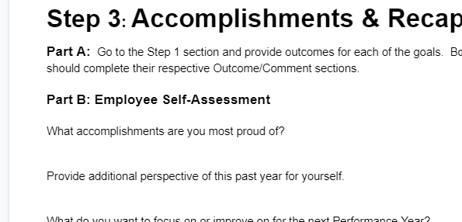
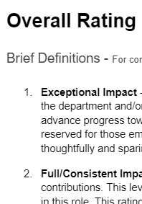
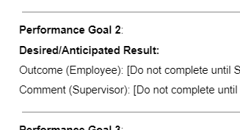
Step 3 in action
Key Actions:
- Schedule dedicated time for this discussion in June/July.
- Build time into calendar for employee and supervisor to complete respective sections prior to discussion.
- Supervisor reviews goal outcomes, mid-year comments and any 1:1 notes about employee’s performance.
- Nothing should be surprising to the employee in the review.
- Sign, scan and email to hr@macalester.edu by July 31.

Slide 11
Giving and Getting Feedback
Delivering and receiving feedback are essential in all parts of the performance management process. Supervisors and employees share equal responsibility in building two-way communications that are frequent and timely.
A common cause of poor work performance is the lack of feedback. Feedback gives information to the employee, which will assist with current and future performance.
Learn about your employee, understand their style of receiving feedback, both positive and constructive.
Give feedback regularly. You should have scheduled 1:1 meetings monthly, at a minimum.
Feedback should be timely. Whether positive or constructive, deliver feedback as soon as possible. You do not have to wait for a scheduled 1:1.
Sometimes you may not have all the information. Listen and reassess the situation, if appropriate.
ROLE OF EMPLOYEE
Share with your supervisor how you best receive feedback.
Be open and remain calm. Focus on the circumstance being discussed. This feedback is about the circumstance and not personal.
If you do not understand the feedback, ask questions and get more details.
If you feel you have been treated unfairly, think about the feedback overnight before responding. Ask for this time, if needed.
Use active listening skills. Restate the feedback to ensure you understand it.
ROLE OF SUPERVISOR

Slide 12
Performance Management: What else?
Staff hired after March 1 of the academic year do not need a formalized review completed. Performance discussions still encouraged.
Supervisor change mid-cycle? Previous and current manager partner on review.
Ensure goal setting is a part of on-boarding activities for new, or newly promoted employees.
Full/Consistent Impact is a good rating.
The performance review is the expectation.
If you need assistance, please reach out to Employment Services.

Slide 13
Performance Management: Next Steps
Supervisor meets with team to discuss department/team goals for the performance year
  This is a great opportunity for the leader to share their goals with the team. This shows transparency and allows the team to understand how their work impacts the bigger picture at Mac.
Supervisor accesses the Staff Employee Performance Review form in Google Drive templates; shares with employee(s).
Utilizing the SMART goal methodology, work together to develop 3 to 4 Performance Goals that tie to specific elements of the employee’s role or work.
  Please have Step 1 of the Staff Employee Performance Review form completed by November 18.

Slide 14
Questions?
Performance Management “Refresher” Sessions
Wednesday, November 2 - All Supervisors
Wednesday, November 9 - All Staff
Additional questions can be directed to hr@macalester.edu.

