Slide 1




I have an HSA. What do I do now?
Presented by: Elisa Lipari
Health savings accounts (HSAs) are individual accounts offered by Optum Bank®, Member FDIC, and are subject to eligibility requirements and restrictions on deposits and withdrawals to avoid IRS penalties. Investments are not FDIC-insured, are not guaranteed and may lose value. State taxes may apply. Fees may reduce earnings on account. The information contained in this presentation is not intended as legal, investment, or tax advice. It is supplied for general educational purposes and with the understanding that Optum does not provide legal, investment, or tax advice. Please contact a competent legal, investment, or tax professional for personal advice on eligibility, investing, tax treatment and restrictions. State taxes may apply. Fees may reduce earnings on account. Federal and state laws and regulations are subject to change.*
Notes:
Welcome! Thank you for joining today. My name is <insert presenters name>.
You’ve likely recently enrolled in a high deductible health plan and opened a health savings account or HSA. Or perhaps you are considering opening one and are wondering what you need to know once you open an account.

Slide 2

What we’ll be talking about today
What is an HSA?
Qualified medical expenses
Manage your account
HSA contributions
Grow you account
Q & A
Appendix
Slides 20 – 31 - Change your contribution amount
Slides 32 – 51 - Setting up investments
Notes:
Today we’re going to become more familiar with what an HSA is, how it works, which includes making deposits, savings and paying for qualified medical expenses. Additionally, we will discuss how to manage your account. We will reserve time at the end to answer any questions you may have.

Slide 3
What is an HSA?
Health Savings Accounts (HSAs) are designed
to help you save and pay for qualified medical expenses
What is an HSA video
Investments are not FDIC insured, are not guaranteed by Optum Bank®, and may lose value.
Notes:
What exactly is a health savings account, also known as an HSA?
An HSA an individual deposit account offering a tax-advantaged means to save for health care expenses both now and in the future.
An HSA works like this:
First you open an account and deposit money into it. The money is deposited into the account income tax-free and the funds belong to you – even funds contributed by your employer. If you change jobs or health plans, the money is still yours to keep.
Next, you save on taxes. The money goes in tax-free, it grows tax-free and comes out tax-free when spent on qualified medical expenses.
Your HSA funds can be used to pay for qualified medical expenses for you, your spouse, and your tax-dependents.
Lastly, you may invest a portion of your HSA dollars in mutual funds once your account balance reaches the minimum investment threshold.

Slide 4
Save on taxes
HSAs have tax benefits:
Money contributed is tax-free*
Interest earned is tax-free*
Withdrawals for qualified medical expenses are tax-free*
Investments are not FDIC insured, are not guaranteed by Optum Bank®, and may lose value.
Notes:
HSAs offer excellent tax benefits and help you make the most of every health care dollar.
Money deposited is not taxed.
Deposits are exempt from federal income tax
Interest earned is not taxed.
All of the interest you earn – both on the deposit account and interest earned through investments -- are generally not taxed.
Money withdrawn to pay for medical expenses is not taxed either.

Slide 5


Qualified medical expenses
Chiropractic care
Acupuncture
Eye glasses
LASIK surgery
Dental treatments
Braces
Hearing aids
Always track expenses and save receipts
Save your receipts with Expense Tracker
Notes:
Use your HSA savings for a wide variety of qualified medical expenses.
Like, chiropractic care, acupuncture, contact lenses, eye glasses, LASIK surgery, dental treatments, braces and even hearing aids. For a detailed list of qualified and non-qualified medical expenses visit IRS.gov.
An easy way to pay for qualified expenses is with the Optum Payment Card. You’ll get one with your account and you can use it wherever MasterCard is accepted.
Remember to track your expenses and save your receipts.
The IRS may ask you for proof of an expense. If it’s not a qualified medical expense, it will be subject to income tax and assessed a 20% penalty.
Receipt vault is a helpful tool that allows Optum account holders to upload and store images of qualified medical receipts through a tablet, computer, or smartphone. This tool gives you a safe and secure place to save receipts for as long as you’d like without worry of them getting lost or ruined. Log in to your account at OptumBank.com and click “Receipt Vault” on the HSA Summary page to get started.
You can find a detailed list of qualified and non-qualified expenses by going to irs.gov.

Slide 6
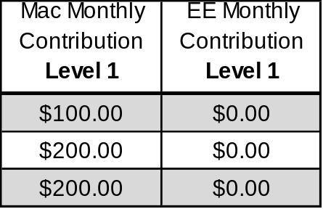
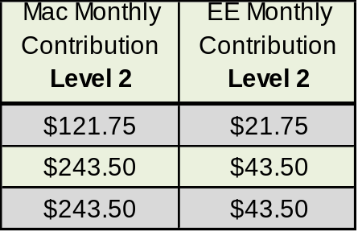
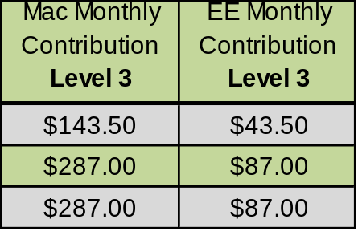
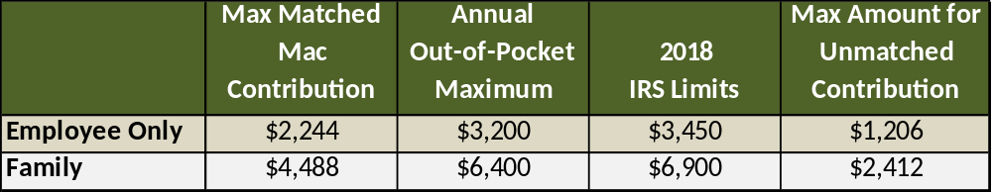
Full-Time HSA Contributions
Open enrollment is an ideal time to review and update your HSA contributions
Investments are not FDIC insured, are not guaranteed by Optum Bank®, and may lose value.

Slide 7
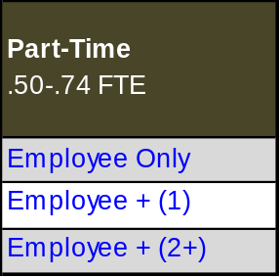
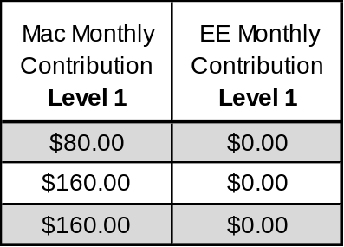
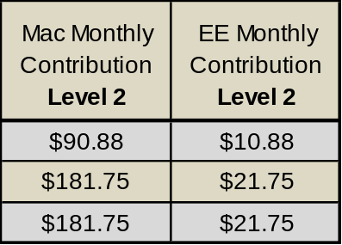
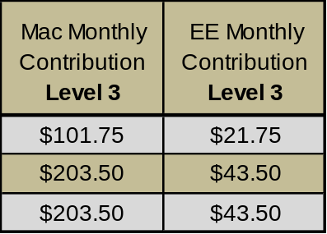
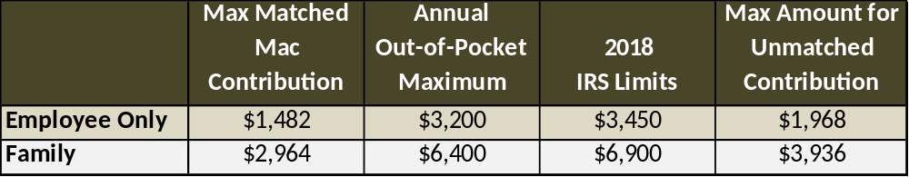
Part-Time HSA Contributions
Open enrollment is an ideal time to review and update your HSA contributions
Investments are not FDIC insured, are not guaranteed by Optum Bank®, and may lose value.

Slide 8
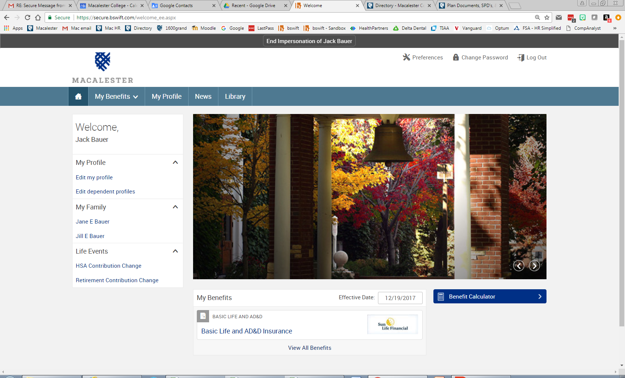
Change your Contribution Amount
Investments are not FDIC insured, are not guaranteed by Optum Bank®, and may lose value.

Slide 9

Manage your account online
myCDH.optum.com
Pay bills
Reimburse yourself
Manage investment activity
Access tools and resources
  Health Savings Checkup
  Expense Tracker
  Quick view account activity
  Educational videos
  … and more!
Investments are not FDIC insured, are not guaranteed by Optum Bank®, and may lose value.
Notes:
Utilize the numerous online features by logging in to your account at myCDH.optum.com. Here, you have the ability to pay bills, make deposits, reimbursement yourself, and manage investments. myCDH.optum.com also has a variety of tools and resources to help you plan and save for health care, including HSA Calculators and Expense Tracker. Remember to periodically check your statements and account activity to ensure fraudulent activity hasn’t occurred. Contact Optum Bank if any questions should arise.

Slide 10
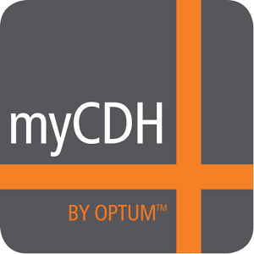
Manage your account on-the-go
MyCDH by Optum
Industry-leading mobile app for your Apple and Android™ devices available in iTunes and Google Play stores
Submit claims
View account messages
Manages expenses with the Expense Tracker
Report lost or stolen Optum payment card
Access account details
  Balances
  Transaction history
Notes:
myCDH also makes it easy to manage your account on the go with a mobile app, myCDH by Optum. This is an industry leading app for both Apple and Android devices. Go to the iTunes or Google Play store and search myCDH by Optum to download for free. Features include the ability to access account details, make a contribution, view account messages, manage expenses and more.

Slide 11
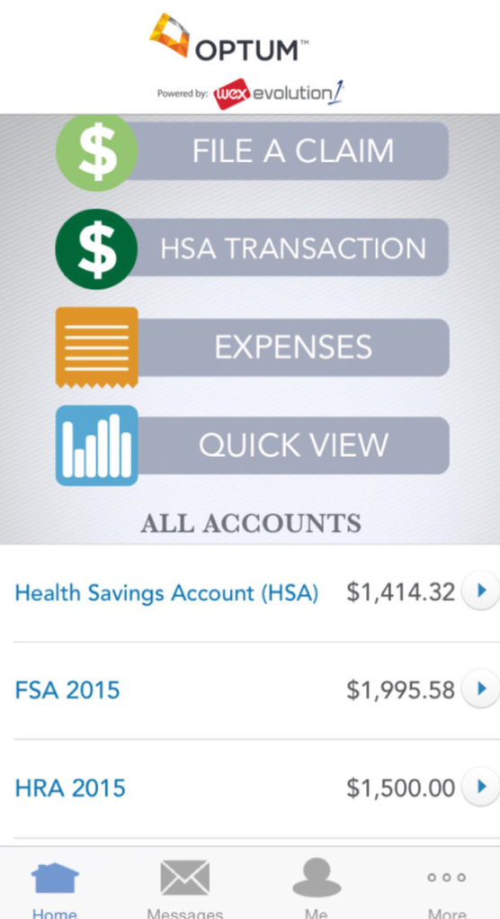
Manage your account on-the-go
MyCDH by Optum’s
Expense Tracker
Enables you to consolidate and help manage your health care bills. Simply:
  Enter your expenses online
  Track and categorize them
  Securely upload a receipt
Notes:
Within the app, there is a great tool called an Expense Tracker. This tool allows you to consolidate and manage your health care bills. Simply, enter your expenses online, track and categorize your expenses and securely upload your receipts.

Slide 12

Let’s look at an example
Mark is single and has a deductible of $1,500. He contributes $2,600
to his HSA this year. He saves:
$650
Federal tax at 25%
$130
State tax at 5%
$199
FICA tax at 7.65%
$979
Total tax savings
Notes:
Let’s look at an example of how Mark’s HSA works for him.
Mark lives in Utah, which does not tax HSAs.
He’s single, and he’s chosen an HSA-qualifying health plan with a $1,500 dollar deductible.
He opens an HSA and deposits $100 from every paycheck, for a total $2,600 for the year.
Since he doesn’t have to pay Federal, State or FICA taxes on the $2,600 he deposited, he saved $979 for the year.

Slide 13
Let’s look at an example
Mark uses his $2600 HSA contribution for:
A doctor’s office visit
A monthly prescription
Used funds
A few chiropractor visits
Funds available for future medical expenses
Notes:
Mark uses his HSA funds to pay for a routine doctor’s office visit, a monthly prescription, and a few chiropractor visits – totaling $680.
He pays for these expenses using his HSA debit card and saves his receipts. At the end of the year his unused balance of $1,920 carries forward.

Slide 14
Grow your account
HSA Investing Video

Slide 15
Quick quiz
1. When am I eligible to invest my HSA dollars in mutual funds?
    When my HSA balance meets the minimum investment threshold
    There are no eligibility requirements
2. Do I pay taxes on money I earn in an HSA investment account?
    Yes, taxes are charged on investment earings
    No, investment earnings are tax free
Investments are not FDIC insured, are not guaranteed by Optum Bank®, and may lose value.
Notes:
First, let’s take a quick quiz, so I can see what you already know.
When am I eligible to invest my HSA dollars in mutual funds?
When my HSA balance meets the minimum investment threshold
There are no eligibility requirements
Do I pay taxes on money I earn in an HSA investment account?
Yes, taxes are charged on investment earnings
No, investment earnings are tax free

Slide 16
Eligibility requirements
HSA BALANCE
MINIMUM
TRANSFER AMOUNT
MINIMUM HSA BALANCE TO
BEGIN INVESTING
$2,500
$100
$2,600
Investments are not FDIC insured, are not guaranteed by Optum Bank®, and may lose value.
Notes:
You become eligible when your HSA cash account balance meets the minimum required balance, which is typically $2,500.
The minimum amount you can transfer is $100. However, your HSA balance needs to stay at $2,500 or more. This means that the amount you choose to transfer cannot bring your balance below that $2,500 mark.
However, after you’ve put some investments in place, it’s okay if your balance drops below $2,500 (such as if you needed to pay for some qualified medical expenses). You just won’t be able to invest any more HSA funds until your balance reaches $2,600 again.

Slide 17
Summary
1
5
An HSA is an account
for health care expenses.
Funds can be used to pay for qualified medical expenses.
2
You must be enrolled in a qualifying high deductible health plan (HDHP).
6
Unused funds roll over each year and earn interest.
3
7
You may increase earnings by investing in mutual funds.
You and your employer can make contributions.
4
HSAs offer tax savings.
8
HSAs are a great short
and long-term savings tool.
Investments are not FDIC insured, are not guaranteed by Optum Bank®, and may lose value.
Notes:
Let’s recap what we’ve learned.
An HSA is a savings account for health care expenses.
You must be enrolled in a high deductible health plan.
You and your employer can make contributions to your HSA.
HSAs offer tax savings.
Funds can be used to pay for qualified medical expenses.
Unused funds roll over each year and earn interest.
You may increase earnings by investing in mutual funds.
HSA’s are a great short and long-term savings tool.

Slide 18

Questions?
Notes:
Now, I would like to open things up for your questions.

Slide 19
Thank you for attending
For further questions, talk to your employer or visit myCDH.optum.com.
Hypothetical example is for illustrative purposes only and assumes an income in the 25% bracket and 5% in a state that does not tax HSA contributions
and a 7.65% FICA rate.
Health Savings Accounts (HSAs) are individual accounts offered by Optum Bank®, Member FDIC, and are subject to eligibility and restrictions on distributions for qualified medical expenses set forth in section 213(d) of the Internal Revenue Code. State taxes may apply. Fees may reduce earnings on account. This communication is not intended as legal or tax advice. Please contact a competent legal or tax professional for personal advice on eligibility, tax treatment, and restrictions. Federal and state laws and regulations are subject to change.*
Hypothetical example is for illustrative purposes only. All events, persons and results described herein are entirely fictitious and amounts will vary depending on your unique circumstances. Any resemblance to real events or persons, living or dead, is purely coincidental. Current rates are variable and may change at any time.
© 2016 Optum, Inc. All Rights Reserved. www.optum.com 50600A-022016
Notes:
If you have questions that come up later, visit myCDH.optum.com.
The website contains lots of easy-to-use information, frequently asked questions, and tools to help you better understand your HSA. Or, you can talk to your benefits representative.

Slide 20
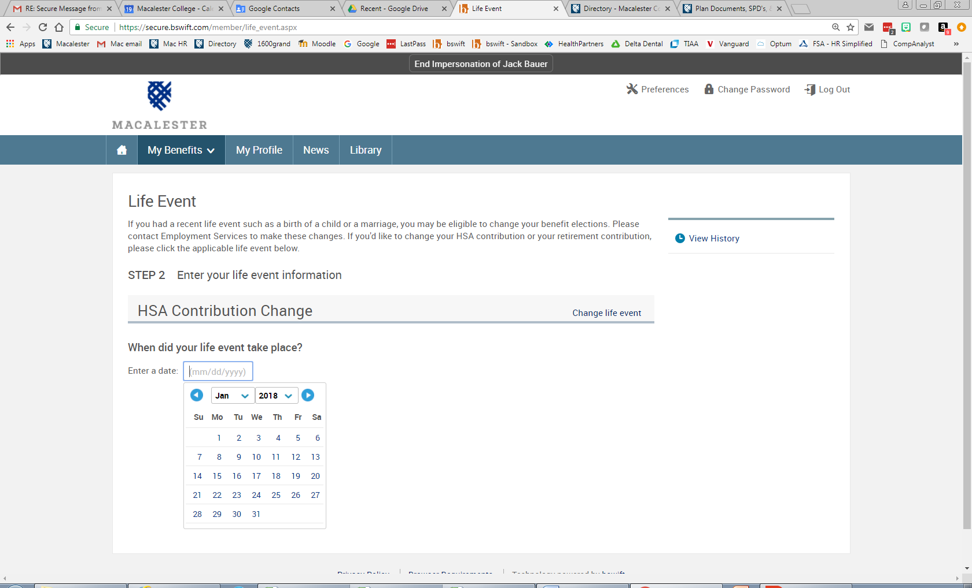
Appendix: Change your contribution amount
Click on today’s date
Click on today’s date

Slide 21
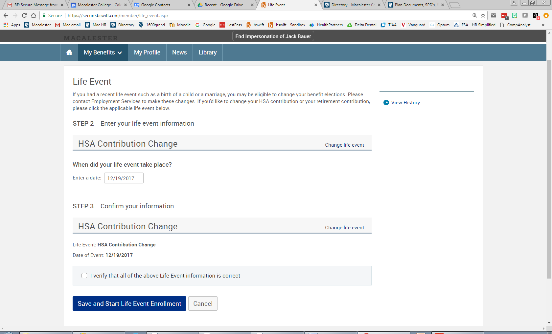
Appendix: Change your contribution amount
Click “I verify”
Click “Save…”

Slide 22
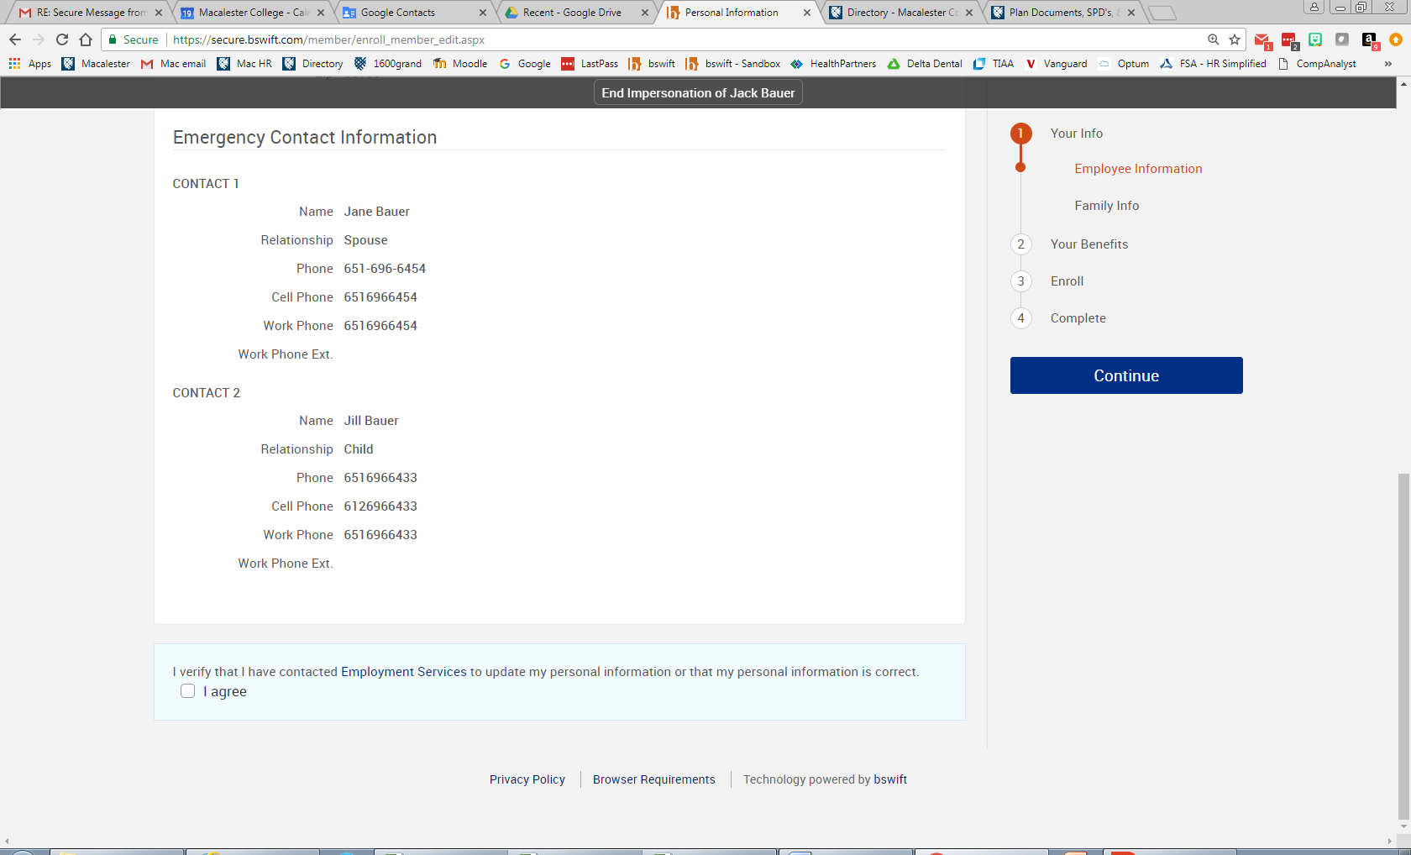
Appendix: Change your contribution amount
Click “I agree”

Slide 23
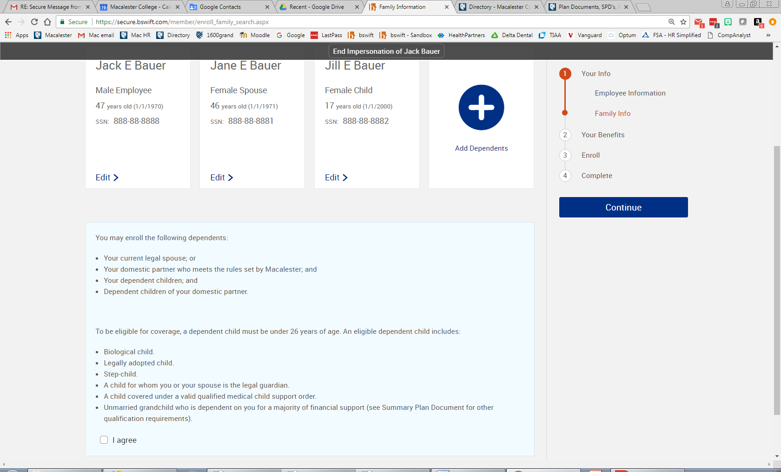
Appendix: Change your contribution amount
Click “I agree”

Slide 24
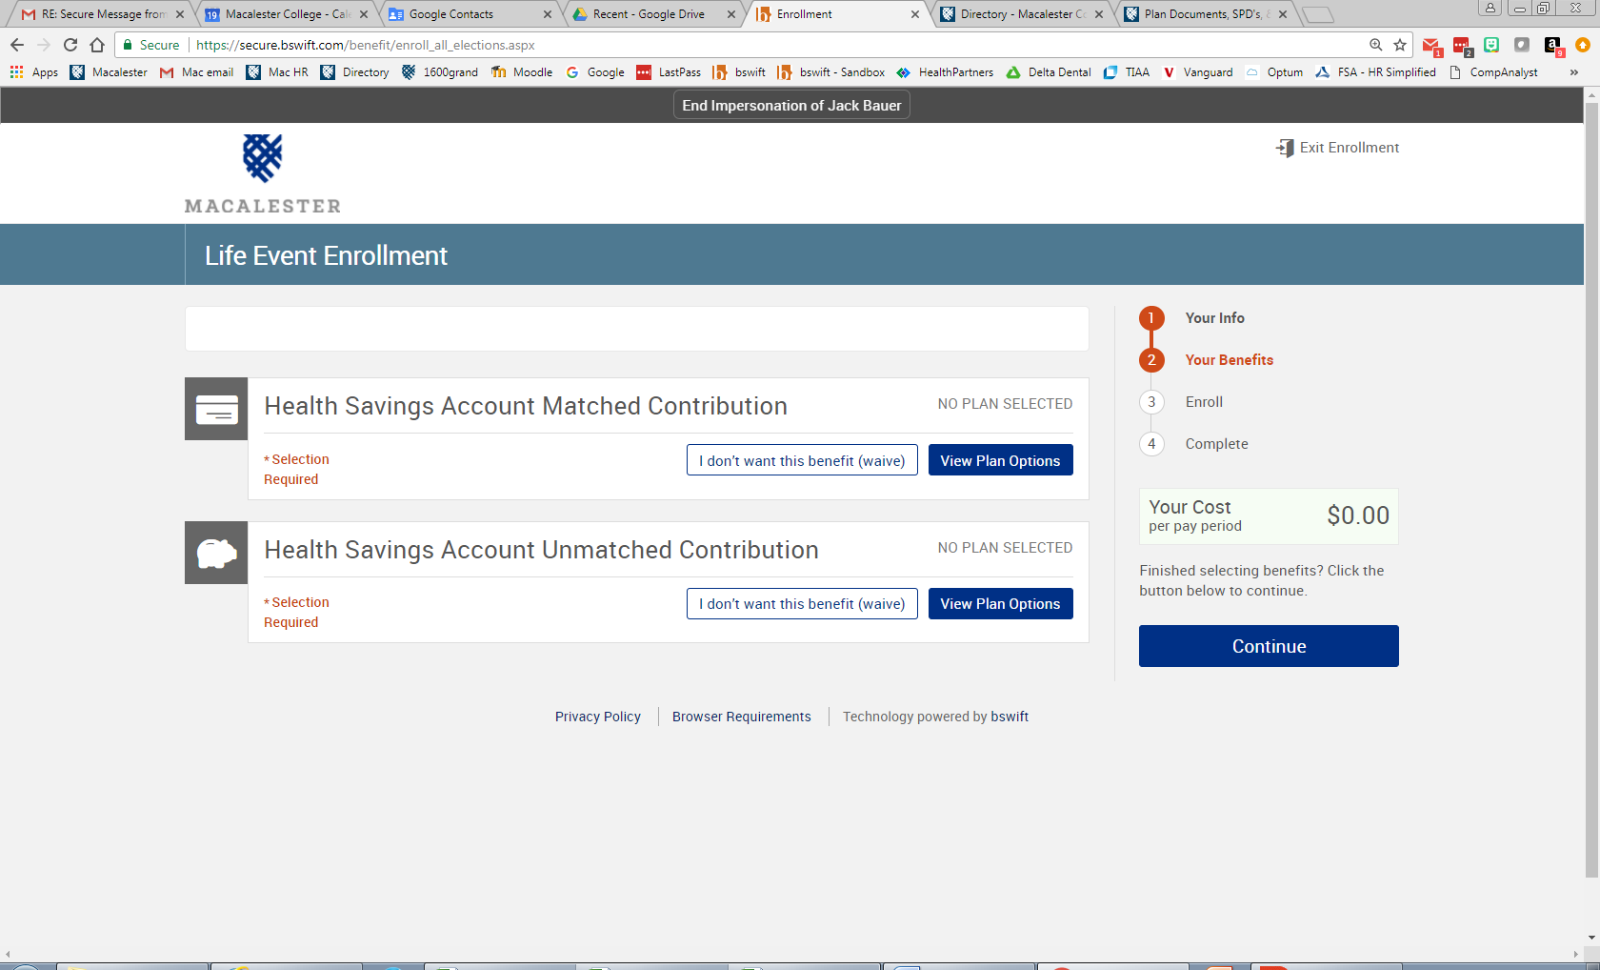
Appendix: Change your contribution amount
Click “View Plan Options”

Slide 25
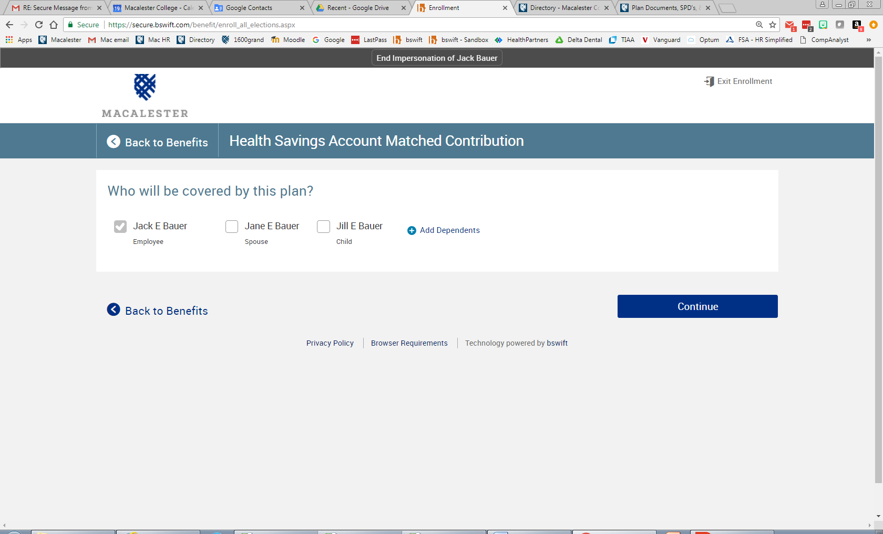
Appendix: Change your contribution amount
Select who is covered on HDHP

Slide 26
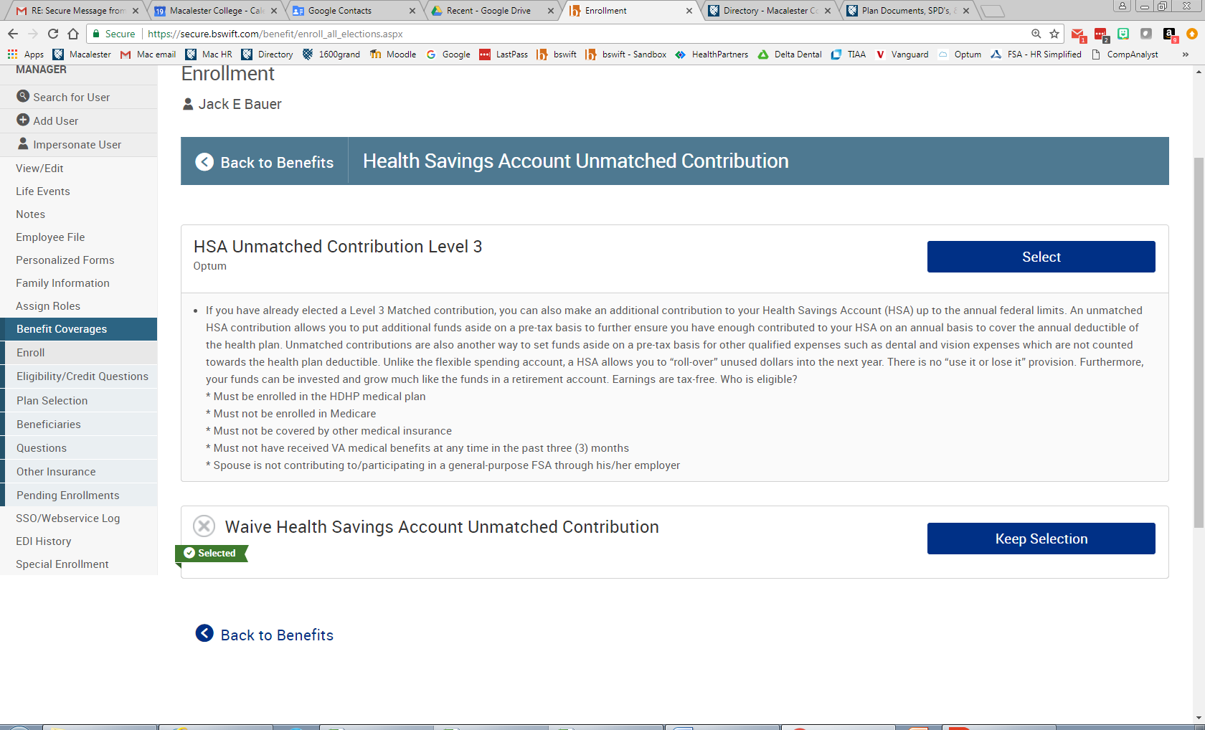
Appendix: Change your contribution amount
Click “Select”

Slide 27
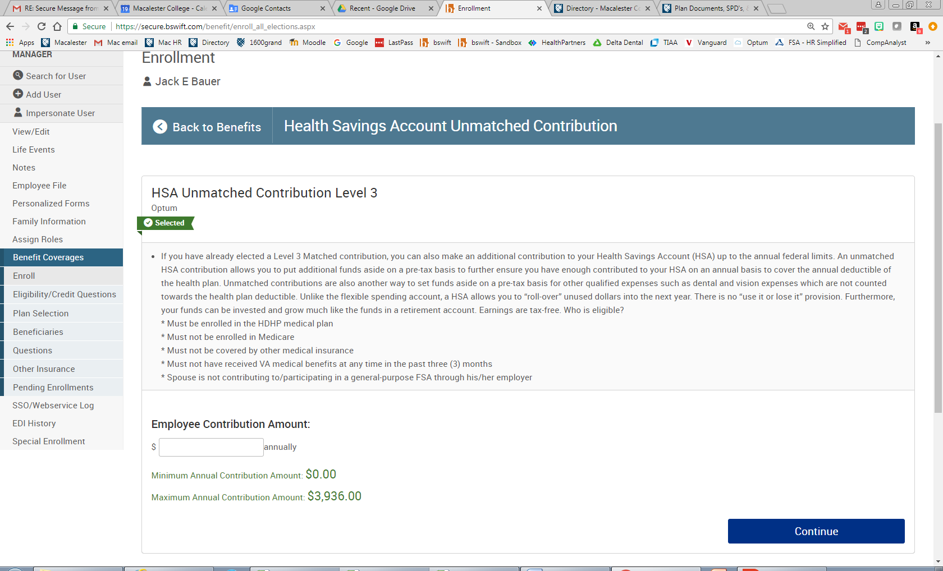
Appendix: Change your contribution amount
Enter “Annual” Contribution Mmount
Up to the Annual Limit

Slide 28

Appendix: Change your contribution amount
Click “Continue

Slide 29
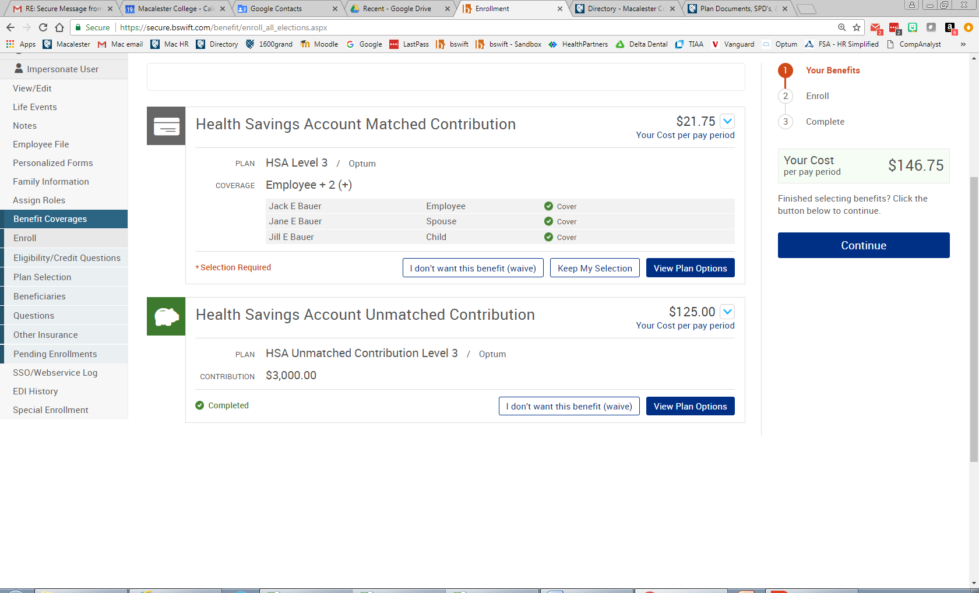
Appendix: Change your contribution amount
Click “Continue”

Slide 30
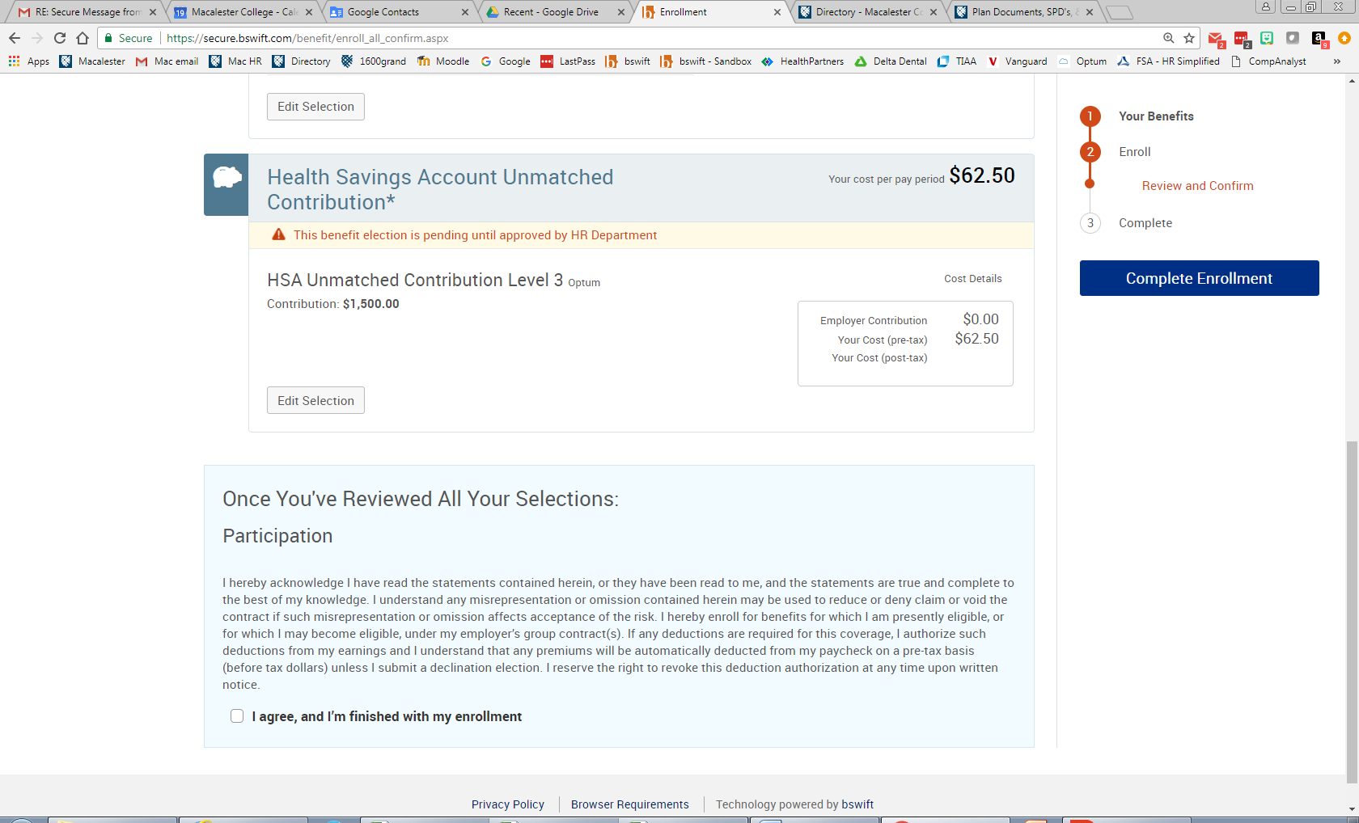
Appendix: Change your contribution amount
Click “I agree” & then click “Complete”

Slide 31
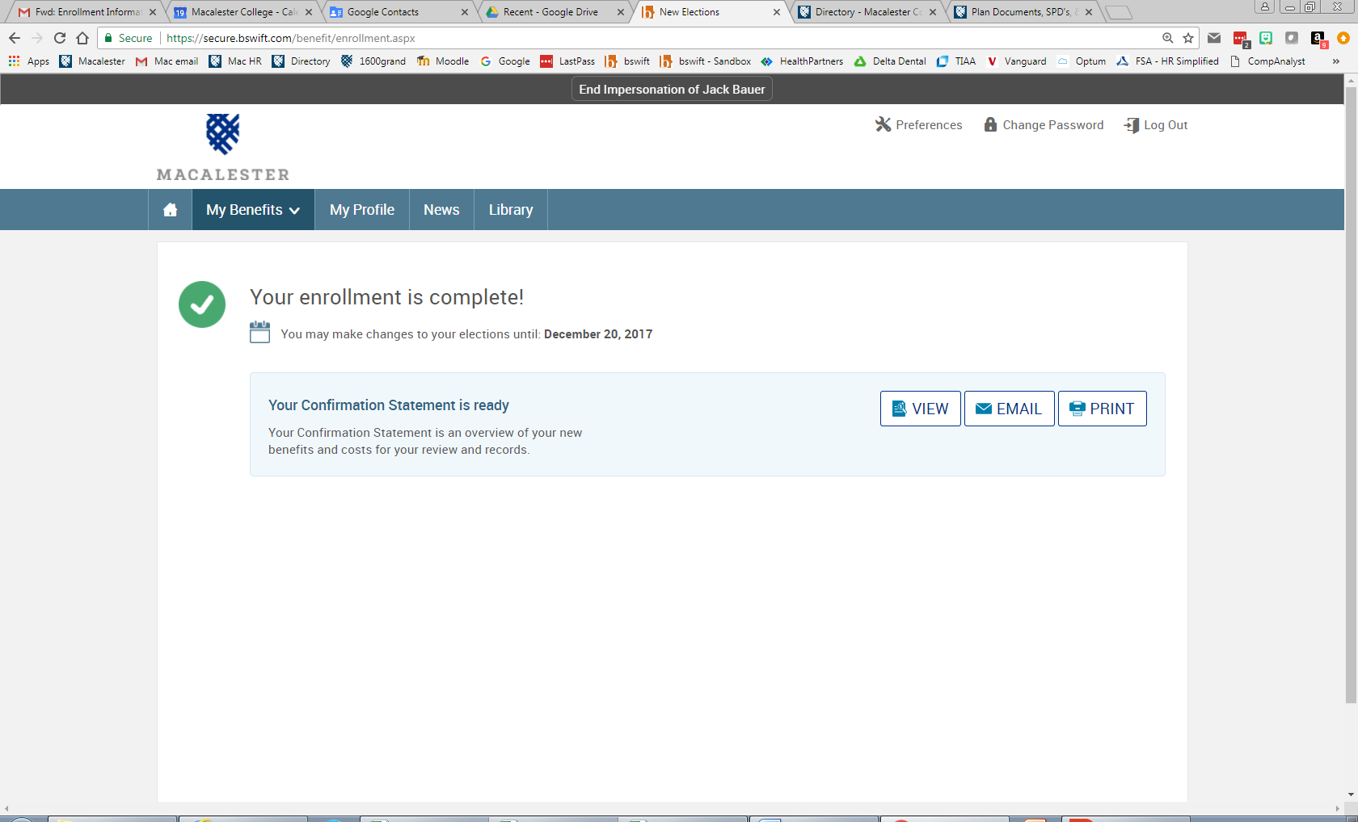
Appendix: Change your contribution amount

Slide 32
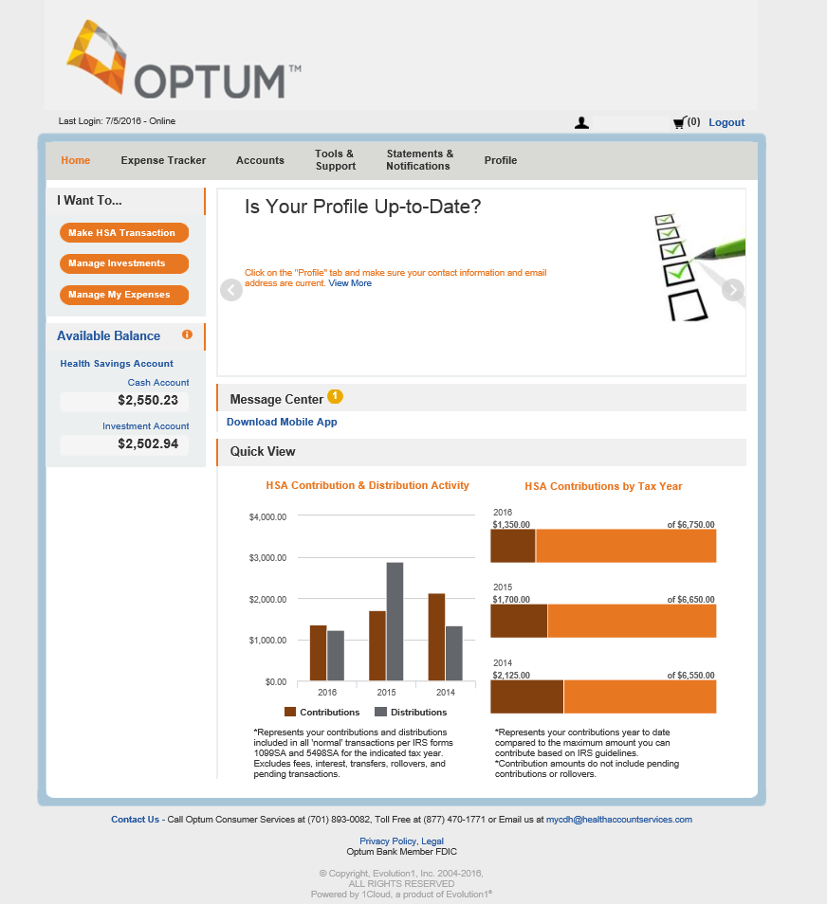
Appendix: Setting up Investments
The HSA Dashboard tab on the myCDH.optum.com toolbar shows:
  Total HSA cash balance
  Investment account balance
Remember:
If your cash account balance exceeds $2,600, you are eligible to invest, if you choose
Investments are not FDIC insured, are not guaranteed by Optum Bank®, and may lose value.
Notes:
To see if you’re eligible, log into your Optum HSA at myCDH.optum.com. You’ll see your current account balance on the left hand side. If your cash account balance exceed $2,600, you are eligible to invest.

Slide 33
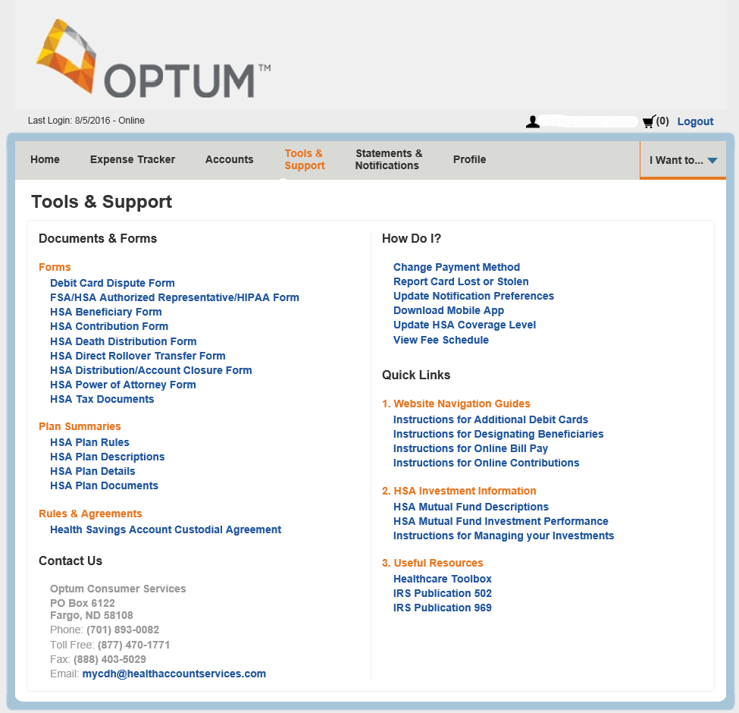

Getting started
Review the education and tools provided at myCDH.optum.com:
  Documents and forms
  Common questions
  Quick links
  Customer service
  … and more!
Investments are not FDIC insured, are not guaranteed by Optum Bank®, and may lose value.
Notes:
Before you get started, review the education and tools available at myCDH.optum.com to learn more and research common investing questions. There are also many educational resources that may be helpful including various documents and forms, commonly asked questions, quick links and access on how to contact Optum, if needed. Once you access the investing feature of myCDH.optum.com, you’ll have access to additional educational tools specific to investing your HSA. Stay tuned, we will review those later.

Slide 34

Step one: Setting allocations
The first step to investing your HSA is setting the allocations for your desired investments based on your personal financial situation, goals and objectives.
Please note: if no allocation is set, 100% of your HSA funds will automatically be invested in the Fidelity Government Money Market fund.
Investments are not FDIC insured, are not guaranteed by Optum Bank®, and may lose value.
Notes:
The first step to investing your HSA is setting the allocations for your desired investments.
Please note: if no allocation is completed, 100% of your funds will automatically be invested in the First American Prime investment account.

Slide 35
Step one: Setting allocations
Log in at myCDH.optum.com
Investments are not FDIC insured, are not guaranteed by Optum Bank®, and may lose value.
Notes:
Creating your investment account takes just six easy steps:
First, log in at myCDH.optum.com by selecting “participant log in.”

Slide 36
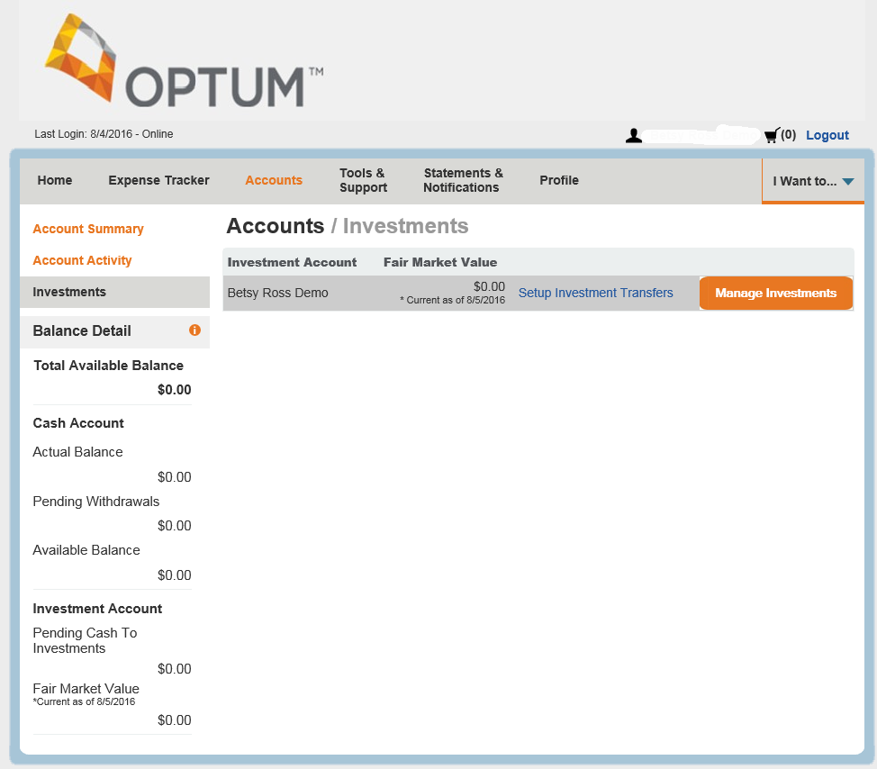

Step one: Setting allocations
Navigate to the investment section of your account
    Click the “Accounts” tab,
    “Investments,” and
    “Manage Investments”
Investments are not FDIC insured, are not guaranteed by Optum Bank®, and may lose value.
Notes:
Next, navigate to the investment section of your account. This can be done by selecting the “Account” tab near the top of the page followed by “Investments” on the left hand side, and finally, click the orange “Manage Investments” button.

Slide 37
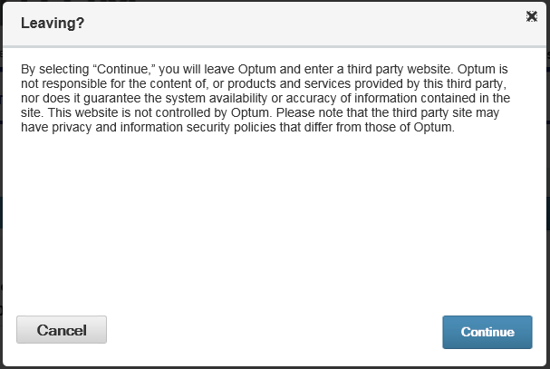
Step one: Setting allocations
Click “Continue” to access the third-party website
Investments are not FDIC insured, are not guaranteed by Optum Bank®, and may lose value.
Notes:
This is bring you to a pop-up. Please click “Continue” in order to be navigated to a third-party website to begin the investing process.

Slide 38
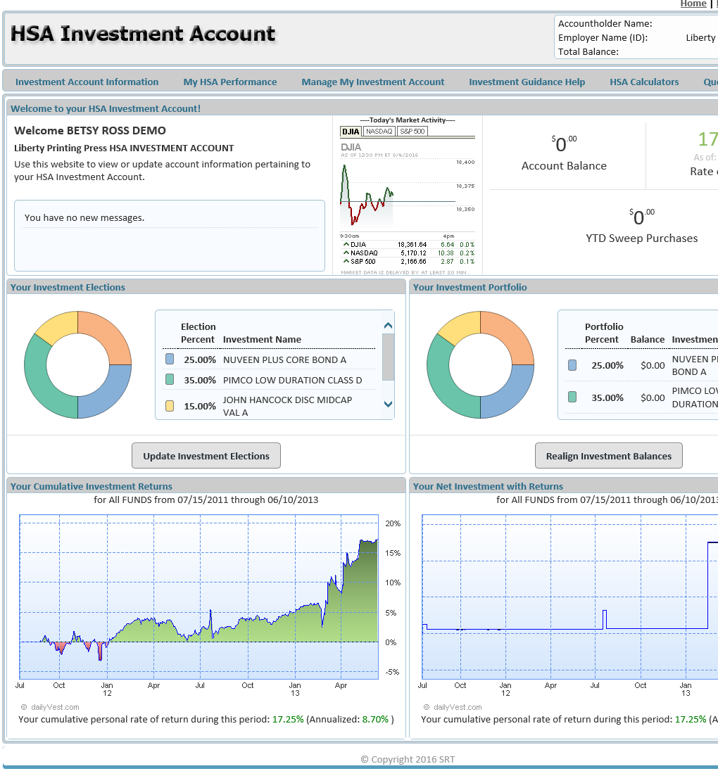
Step one: Setting allocations
Select the “Manage My Investment Account” tab
    Click “Update Investment Elections”
Investments are not FDIC insured, are not guaranteed by Optum Bank®, and may lose value.
Notes:
Once you have navigated to the third-party website, your screen will be as shown. Select the “Manage My Investment Account” tab near the top, followed by “Update Investment Elections” that appears in the drop down.

Slide 39
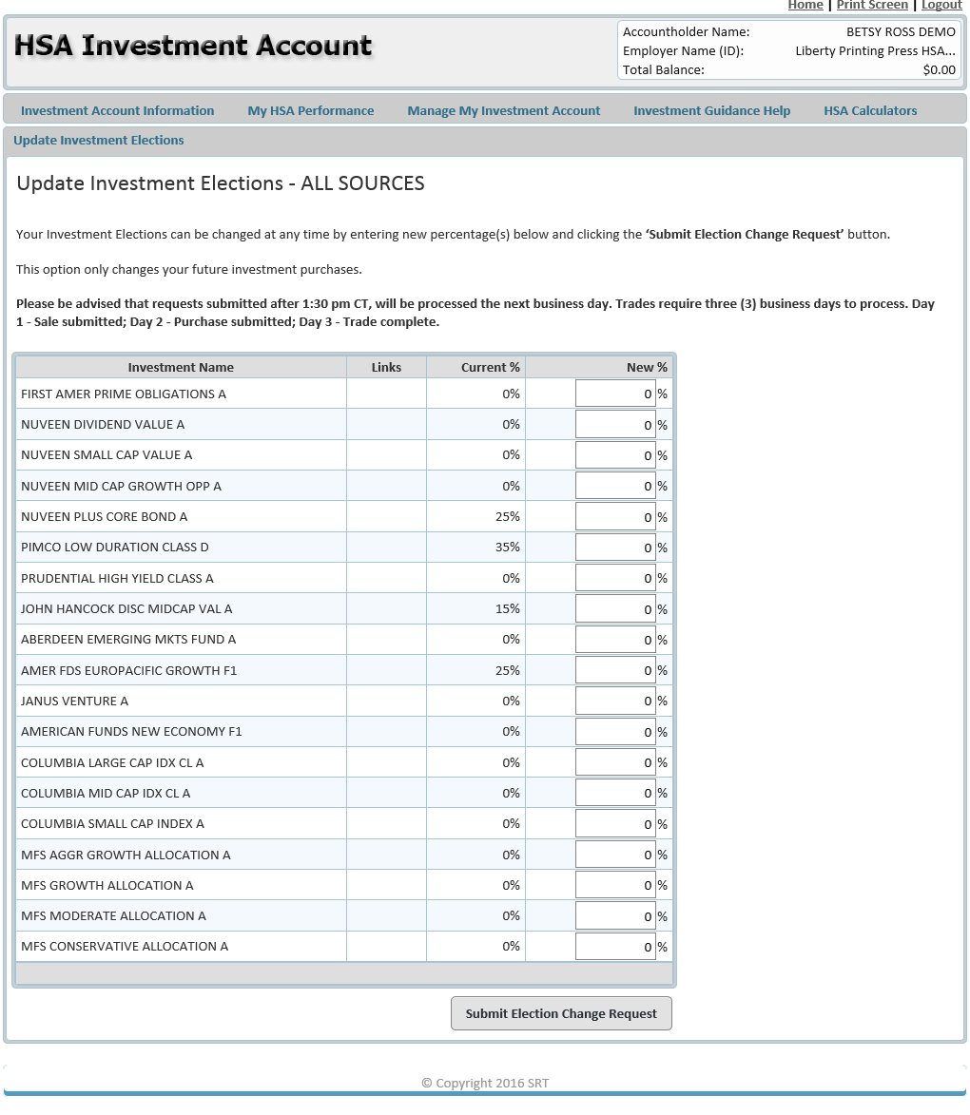
Step one: Setting allocations
Designate your desired allocations
Investments are not FDIC insured, are not guaranteed by Optum Bank®, and may lose value.
Notes:
This is where you enter your desired allocation percentages. We will review tools and resources shortly to help with your decision, but please remember that if no allocation is completed, 100% of your funds will automatically be invested in the First American Prime investment account.

Slide 40
Step one: Setting allocations
Click “Submit Election Change Request”
Investments are not FDIC insured, are not guaranteed by Optum Bank®, and may lose value.
Notes:
The final step is to select “Submit Election Change Request.” Congratulations! You‘ve completed the first aspect to investing with your HSA.

Slide 41
Step two: Setting up transfers
In order for your HSA funds to be invested, you need to complete one final step: setting up your investment transfer threshold and sweeps.
Please note: if no investment transfer threshold is set, your HSA funds will not be transferred to your investment account.
Investments are not FDIC insured, are not guaranteed by Optum Bank®, and may lose value.
Notes:
The next step is to set up fund transfers. In order for your HSA funds to be invested, you need one final step: setting up your investment transfer threshold and sweeps.
Please note: if no investment transfer threshold is set, your HSA funds will not be transferred to your investment account. We will review sweeps and transfers to help make you more familiar.

Slide 42
Transfers and sweeps
What is an investment transfer threshold?
    The investment transfer threshold sets the maximum amount of funds to remain in your HSA cash account. All funds exceeding this threshold will be moved automatically from your HSA cash account to your investment account.
    The threshold can be increments of $100 within a minimum value of $2,500.
What is a sweep?
    A sweep is the process of Optum automatically moving the funds from your HSA cash account to your investment account when the funds in your HSA cash account exceed your investment transfer threshold.
    If your account balance falls below the investment transfer threshold, funds will be automatically swept back to your HSA cash account from your investment account.
Investments are not FDIC insured, are not guaranteed by Optum Bank®, and may lose value.
Notes:
You may be asking, what is an investment transfer threshold? What’s a sweep?
The investment transfer threshold sets the maximum amount of funds to remain in your HSA cash account. All funds exceeding this threshold will be moved automatically from your HSA cash account to your investment account. As mentioned, the threshold can be increments of $100 within a minimum value of $2,500.
A sweep is the process of Optum automatically moving the funds from your HSA cash account to your investment account when the funds in your HSA cash account exceed your investment transfer threshold. If your account balance falls below the investment transfer threshold, funds will be automatically swept back to your HSA cash account from your investment account.
For example, if an account holder’s cash account balance is $2,550, this will not trigger a sweep because it does not meet the $100 minimum sweep transaction amount. But, if an account holder’s balance is $2,950, Optum’s system will trigger a sweep transaction that will initiate an investment buy in the amount of $350.

Slide 43
Transfers and sweeps
Example:
Investment transfer threshold is set at $2,800
$2,700
+ $600
$3,300
- $500
$2,800
Account balance as of April 1st
HSA deposit on April 6th
New HSA balance
Automatic transfer/sweep to investment account
New HSA balance
Investments are not FDIC insured, are not guaranteed by Optum Bank®, and may lose value.
Notes:
Let’s go through an example. Say you set your recurring transfer threshold at $2,800. As of April 1st, your HSA balance is $2,700, but you make a deposit on the 6th for $600. This brings your total HSA balance to $3,300. Again, your recurring transfer threshold is set at $2,800. Because of this, $500 will be automatically transferred to your HSA investment account, bringing your HSA balance to $2,800.

Slide 44
Step two: Setting up transfers
Select “Setup Investment Transfers”
Investments are not FDIC insured, are not guaranteed by Optum Bank®, and may lose value.
Notes:
First, select “Setup Investment Transfers” on the investment page after you log in at myCDH.optum.com.

Slide 45
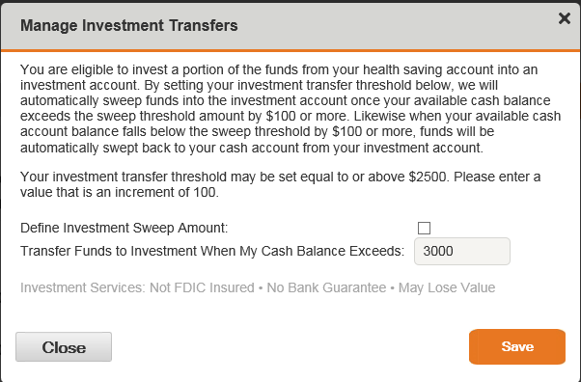
Step two: Setting up transfers
Check the checkbox and enter desired investment threshold
    Your investment transfer threshold may be $2,500 or more in increments of $100
Investments are not FDIC insured, are not guaranteed by Optum Bank®, and may lose value.
Notes:
The select the checkbox and enter your desired investment threshold.
Your investment transfer threshold may be $2,500 or more, but must be in increments of $100.

Slide 46
Account management tools
Investment homepage
  Snapshot view of:
    Account messages
    Daily market activity
    Account balance
    Investment elections
    Investment portfolio
    Investment returns
    … and more!
Investments are not FDIC insured, are not guaranteed by Optum Bank®, and may lose value.
Notes:
There are many account management tools available for you online at myCDH.optum.com. Once you navigate to the third-party website, the homepage allows you to view a snapshot of:
Account messages
Daily market activity
Your account balances
Your investment elections, portfolio and returns on investments

Slide 47
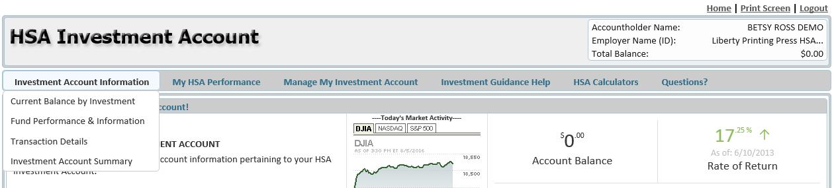
Account management tools
Investment Account Information
  Current balance by investment
  Fund performance & information
  Transaction details
  Investment account summary
Investments are not FDIC insured, are not guaranteed by Optum Bank®, and may lose value.
Notes:
When you click the “Investment Account Information” tab, you can also find your current balance by investment, fund performance, transaction details and a detailed summary of your account.

Slide 48
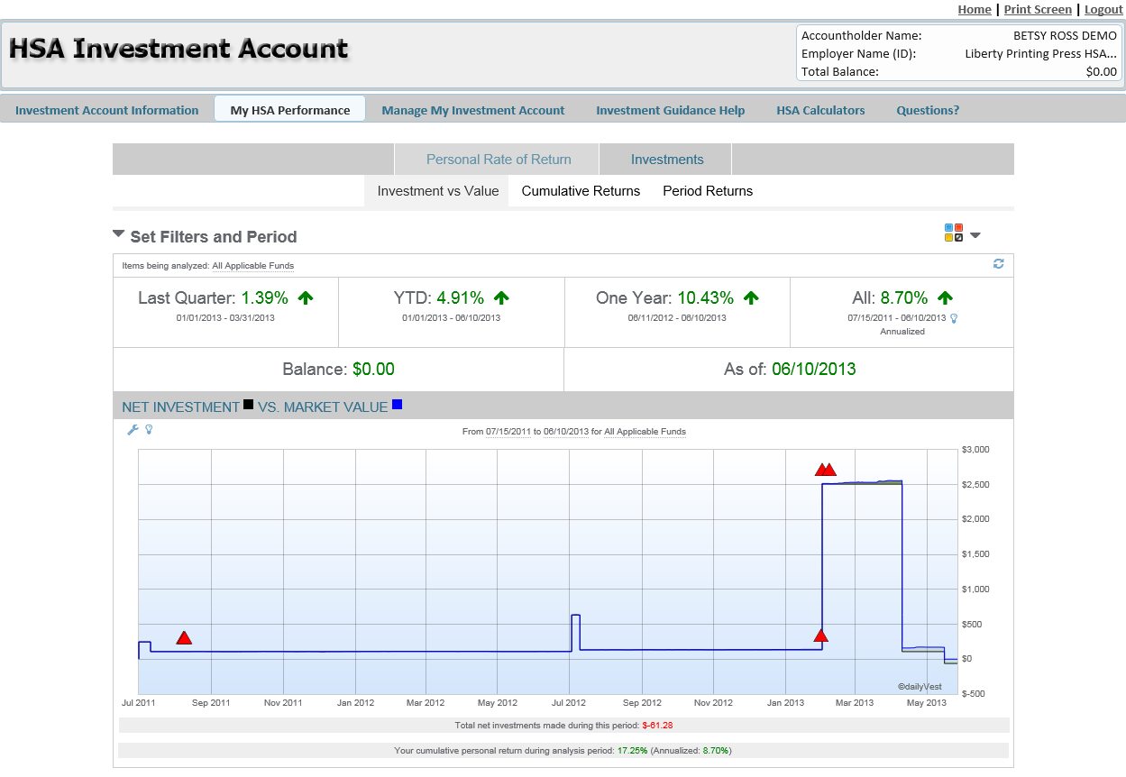
Account management tools
My HSA Performance
  Personal rate of return
  Investments
Investments are not FDIC insured, are not guaranteed by Optum Bank®, and may lose value.
Notes:
The next tab, “My HSA Performance” shows your personal rate of return and other investment related information specific to your investment elections.

Slide 49
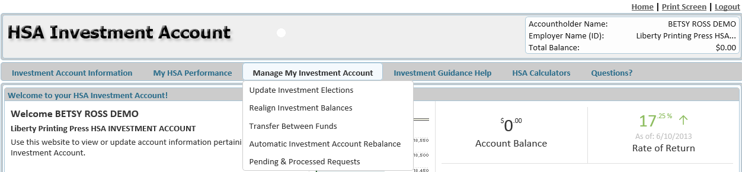
Account management tools
Manage My Investment Account
  Update investment elections
  Realign investment balances
  Transfer between funds
  Automatic investment account rebalance
  Pending & processed requests
Investments are not FDIC insured, are not guaranteed by Optum Bank®, and may lose value.
Notes:
“Manage My Investment Account” is where we visited earlier to set allocations. Under this tab you can update investment elections or allocations, realign investment balances, transfer between funds, automatically rebalance your investment account and view pending and processed requests.

Slide 50
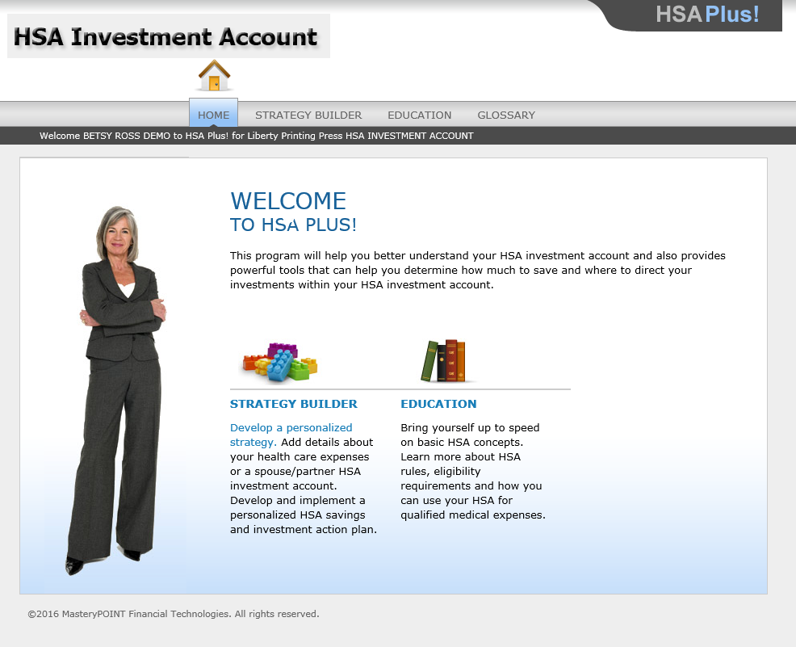
Account management tools
Investment Guidance Help
  Strategy Builder
  Education
Investments are not FDIC insured, are not guaranteed by Optum Bank®, and may lose value.
Notes:
The “Investment Guidance Help” tab provides access to Strategy Builder and additional educational tools. Strategy Builder allows you to add details about your health care expenses and/or spouse information in order to develop a personalized HSA savings and investment action plan. The educational tools cover everything from HSA rules, eligibility requirements and qualified medical expenses.

Slide 51
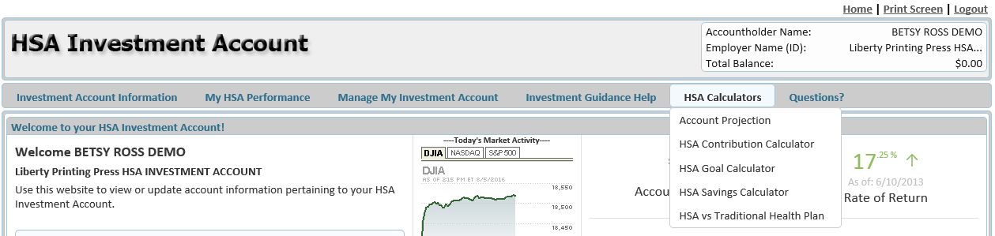
Account management tools
HSA Calculators
  Account projection
  HSA contribution calculator
  HSA goal calculator
  HSA savings calculator
  HSA vs Traditional Health Plan
Notes:
Finally, the “HSA Calculators” tab give you access to 5 different tools including:
Account projection
HSA contribution calculator
HSA goal calculator
HSA savings calculator
And a calculator to show the differences between an HSA and a Traditional Health Plan
Each of these tools can help you better use and understand your HSA.

