Slide 1


2026 Benefits Guide

Slide 2

AGENDA
Changes for 2026
What is Open Enrollment
Benefit Plan Overview
Enrollment Process
WHAM

Slide 3
Changes for 2026
Premium increases
HSA Model Update
Dependent Care FSA
Short-Term Disability & Minnesota Paid Leave

Slide 4
Premium Increases
Health Insurance
Initial Renewal – 20%
Final Increase – 9.99%
Dental Insurance
3.00% increase
Vision Insurance
Increase to employee only tier – based on utilization
Minor changes for other tiers

Slide 5
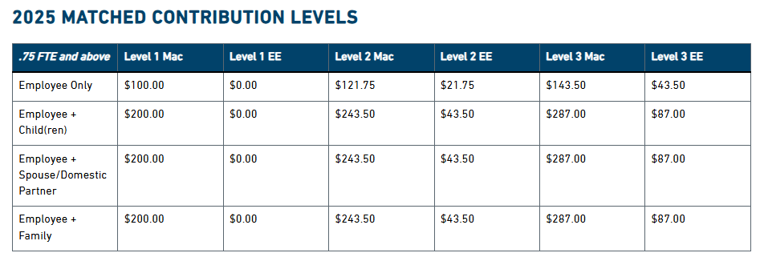
Current HSA Model
This model will end 12/31/2025

Slide 6
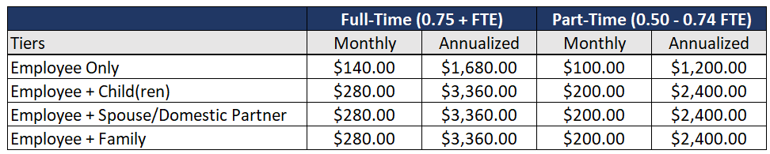
HSA Model Update
Equitable
Straightforward
Removes Barriers

Slide 7
Dependent Care FSA
Increase from $5,000 to $7,500
First increase in 38 years
Big WIN for parents!

Slide 8
Short-Term Disability & Minnesota Paid Leave
Short Term Disability
Medical Reason Only
Bridges pay gap
Minnesota Paid Leave
Medical & Family Reasons
Bridges pay gap
100% premium paid by employees
New tax split 50%-50%

Slide 9
What is Open Enrollment?
Opportunity to make changes to your benefit elections and to review which dependents you will cover
Elections made during this period will remain in effect through 12/31/26, unless you experience a qualified life event
Events include:
  Marriage or Divorce
  Death
  Birth or adoption of a dependent
  Change in employment status for employee or spouse/domestic partner
  Turning 26
You have 30 days from the date of the event to notify Human Resources if you wish to make a change and will require you to provide documentation supporting the life event change.

Slide 10

Health Plan

Slide 11
Health Plan Definitions
Copay | Flat dollar amount member is responsible for at the time of service. The plan usually pays 100% of the remaining balance.
Deductible | Amount member is responsible for before the plan pays for certain services.
Coinsurance | Percentage of payment shared between the member and the plan for certain services after the deductible has been met.
Out-of-Pocket Maximum | Total payments for deductible, coinsurance and copays. Once reached, the plan pays 100% for the rest of the year.
In-network Provider | Medical and pharmacy providers that have contracted with the plan to provide lower out-of-pocket costs for members.

Slide 12
Health Plan Highlights
PREVENTIVE CARE – Covered at 100% under both plans.
Routine preventive for children*
Routine preventive for Adults
Appropriate screenings based on sex and age
  Newborn visits
  Tuberculosis testing
  Anemia testing
  Lead exposure
  Pelvic exam and pap test
  Development behavior
  Lipid profile
  Depression
  Obesity and counseling
  Nutrition counseling
*Birth to age 18
Appropriate screenings based on sex and age
  Annual exams
  Pelvic exam and pap testing
  Breast exam and mammogram
  Bone density testing
  Colonoscopy
  Routine vision and hearing exams

Slide 13
Premium Sharing

Slide 14
Health Plan Highlights
 | HDHP/HSA PLAN OPTION #1 In-network | PPO PLAN OPTION #2 In-network
Annual Deductible | $3,500 per individual $7,000 per family | $500 per individual $1,000 per family
Annual Out-of-Pocket Maximum** | $3,500 per individual $7,000 per family | $3,500 per individual $7,000 per family
Primary Care Office Visit Specialty Care Office Visit | 100% after deductible | $30 copay $50 copay
Emergency Room | 100% after deductible | $100 copay
Outpatient Hospital | 100% after deductible | 80% after deductible
Inpatient Hospital | 100% after deductible | 80% after deductible
Emergency Room | 100% after deductible | $100 copay
Retail Prescription Drugs (30-day Supply) Mail order for Generic & Preferred Brand Name 2 copays for 90-day supply
Generic | 100% after deductible | $15 copay
Preferred Brand Name | 100% after deductible | $40 copay
Non-Formulary Generic or Brand Name | 100% after deductible | 80% coverage
Preferred Specialty | 100% after deductible | 80%; max of $300 per script
** The out-of-pocket maximum includes copays, deductible, and coinsurance.

Slide 15

Health Plan Network
Finding A Network Provider
Remember you pay less when you seek care within the network. To find an Open Access network provider:
  Visit www.healthpartners.com/openaccess
  Log into your HealthPartners account or myHP mobile app
  Call the number on the back of your ID card

Slide 16
Health Plan Monthly Premiums
Full-Time Rates (0.75 FTE and above)
 | High Deductible |  | PPO
Tier Level | Employee Cost | Mac Cost | Employee Cost | Mac Cost
Employee Only | $160.77 | $643.08 | $242.67 | $970.68
Employee + Child(ren) | $359.31 | $838.39 | $547.09 | $1,276.54
Employee + Spouse/Domestic Partner | $557.85 | $1,301.65 | $851.51 | $1,986.85
Employee + Family | $705.79 | $1,646.84 | $1,078.65 | $2,516.86
Part-Time Rates (0.50 – 0.74 FTE)
 | High Deductible |  | PPO
Tier Level | Employee Cost | Mac Cost | Employee Cost | Mac Cost
Employee Only | $351.54 | $482.31 | $485.34 | $728.01
Employee + Child(ren) | $598.85 | $598.85 | $911.82 | $911.82
Employee + Spouse/Domestic Partner | $929.75 | $929.75 | $1,419.18 | $1,419.18
Employee + Family | $1,176.32 | $1,176.32 | $1,797.76 | $1,797.76

Slide 17
How do I Maximize my Benefits?
Am I using in-network facilities and providers?
Do I know the urgent care facilities near my home for minor emergencies?
Have I asked my doctor or pharmacist for lower cost prescription alternatives or shopped around pharmacies for lower prices?
Have my family and I had our annual preventive services performed?
Do I know where I stand regarding my deductible and coinsurance before services are received?
Have I checked my Explanation of Benefits (EOB) to compare it to provider charges?
Which plan should I choose? Often times the cost ends up being less under the HDHP because of the employer funded HSA and the ability to contribute pre-tax.

Slide 18

Nice Healthcare

Slide 19

What is Nice?
On-demand in-home and virtual care affordably priced, easily accessible, and uniquely positioned to keep patients on the right care track.
  Same-Day Chat and Video Visists
  In-Home Visits with 35 Free Labs and Physical Tests
  550+ Free Medications Can Be Prescribed by Nice Clinicians
  Virtual Physical Therapy Visits
  Virtual Mental Health Visits
  In-Home X-rays and EKG Services
Who’s Eligible for Nice?
Spouses/Domestic Partners and Dependent Children up to age 26 of employees who are enrolled in one of our health plans may utilize Nice Healthcare, even if the Spouse/Domestic Partner or children are not enrolled on our health plan.

Slide 20

Health Savings Accounts (HSA)

Slide 21
Health Savings Accounts (HSA)
A health savings account (HSA) is an account that you can use to pay medical expenses.
  Must be in conjunction with a high-deductible health plan (HDHP)
  Triple tax-advantages: Contribute pre-tax money, funds accrue tax-free and withdraw funds tax-free, if used for eligible medical expenses
  You own the account even if you leave
You are not eligible for an HSA if you’re:
  Not covered by a HDHP
  Enrolled in Medicare A, B, or D
  Covered under other health insurance (including a spouse’s full flex plan)
  Another person’s tax dependent

Slide 22
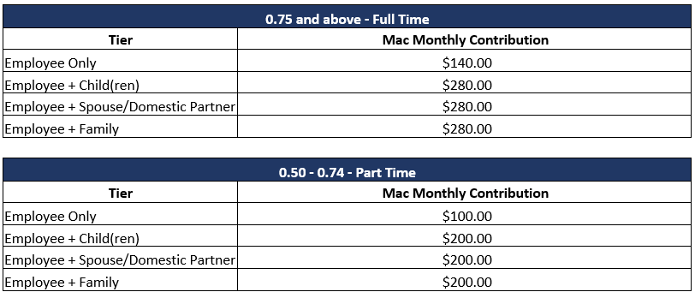
HSA: How much can I contribute?
Individual Enrollment: $4,400*
Family Enrollment: $8,750*
*Those age 55+ can contribute an additional $1,000 “catch-up” each year.
The maximums are employee and Macalester contributions combined
(matched and unmatched contributions)

Slide 23
HSA Contribution
Health Savings Account
 | Full-Time |  | Part-Time
 | Employee | Employee+ | Employee | Employee+
Annual Deductible | $3,500 | $7,000 | $3,500 | $7,000
Mac HSA Contribution | $1,680 | $3,360 | $1,200 | $2,400
EE Out-of-Pocket Exposure | $1,820 | $3,640 | $2,300 | $5,100
Macalester’s HSA contribution covers 48% of the employees HDHP deductible.
While Macalester provides a generous HSA contribution, we still encourage employees to make contributions themselves.

Slide 24
HSA: Distribution Rules
Distribution from your HSA are tax-free if they are taken for qualified medical expenses.
Qualified medical expenses include:
Medical care subject to your deductible & coinsurance
Over-the-counter drugs
Dental & vision services
Select insurance premiums (COBRA, long term care, Medicare, etc.)
Non-qualified expenses include cosmetic surgery, teeth whitening, vitamins, etc.
If you use HSA funds for non-eligible expenses, you will be subject to income tax on the distribution and an additional 20 percent penalty.
If you are age 65+, you will not incur the penalty, but will pay taxes.
HSA distributions can be taken for qualified medical expenses for the following people:
The account holder (person covered by the HDHP)
Spouse of that individual (even if not covered by the HDHP)
Tax dependent children of that individual (even if not covered by the HDHP)

Slide 25

Flexible Spending Accounts (FSA)

Slide 26
Medical Flexible Spending Accounts
Healthcare FSA
Available to those enrolled in the PPO/Copay Plan (Option 2)
Deduct money pre-tax to pay for eligible medical expenses not covered by the medical plan such as deductible, coinsurance, prescription drug copays, dental, and vision expenses
Limited Healthcare FSA
Available to those enrolled in the HDHP/HSA plan (Option 1)
Deduct money pre-tax to pay for eligible dental and vision expenses only
Both FSA’s
$3,400 maximum contribution
Plan year is 1/1 through 12/31
$680 carry over each year; “use it or lose it” for anything over $680
You must elect to participate in the plan. Elections do not roll over from one year to the next.

Slide 27
Dependent Care FSA Plan
Dependent Care FSA’s annual maximum is $7,500
This program lets you pay for certain dependent daycare expenses with pre-tax dollars
Eligible for care while parents are at work or school
ONLY amount payroll deducted to date is available for distribution
Some examples include:
  Daycare/Preschool for dependent children to age 13
  Adult daycare
  Before and after school programs
  Camps
Rollover provision does not apply. Use it or lose it rule applies

Slide 28

Dental Plan

Slide 29
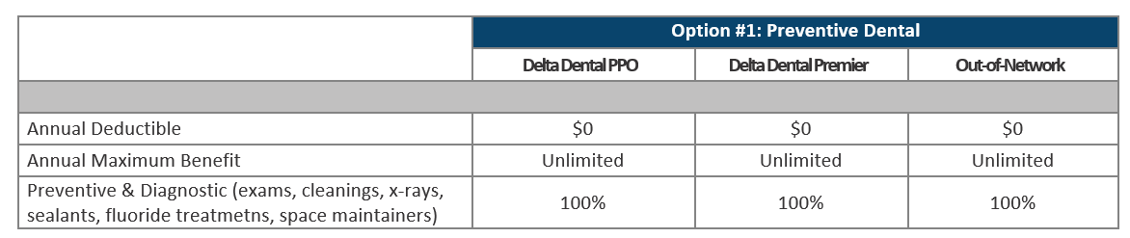
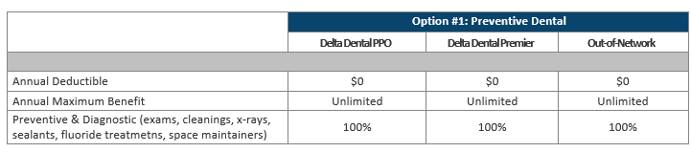
Dental Plan Highlights
Option 1: Preventive Dental

Slide 30
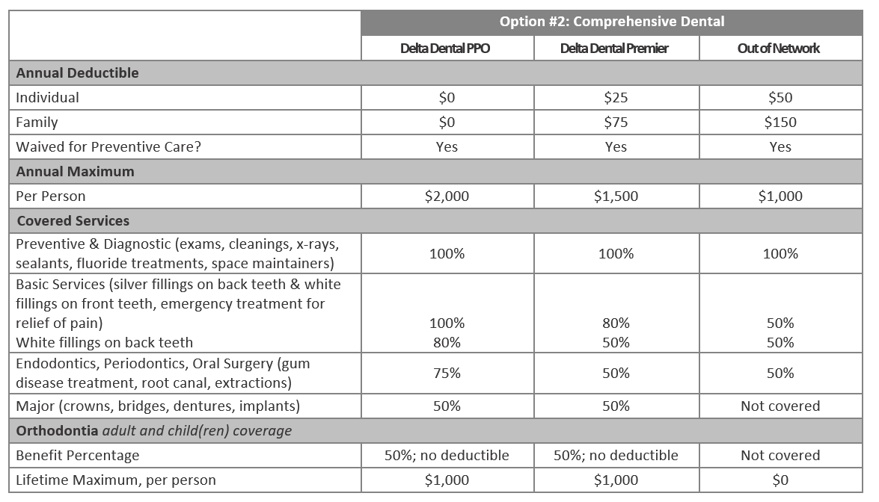
Dental Plan Highlights
Option 2: Comprehensive Dental

Slide 31
Dental Plan Network
Finding A Network Provider
Go to www.deltadentalmn.org/find-a-dentist, search Delta Dental PPO and Delta Dental Premier
Download Delta Dental mobile app
Call the number on the back of your ID card
When an out-of-network provider is chosen, you may be subject to balance billing (the difference between what your provider charges and what Delta Dental will reimburse).

Slide 32
Dental Plan Monthly Premiums
3% increase to premiums for 2026
 | Preventive Dental |  | Comprehensive Dental
Tier Level | Employee Cost | Mac Cost | Employee Cost | Mac Cost
Employee Only | $5.08 | $20.31 | $24.28 | $24.28
Employee + 1 | $14.56 | $33.98 | $59.58 | $39.72
Employee + 2+ | $24.48 | $57.12 | $99.30 | $66.20

Slide 33

Vision Plan

Slide 34
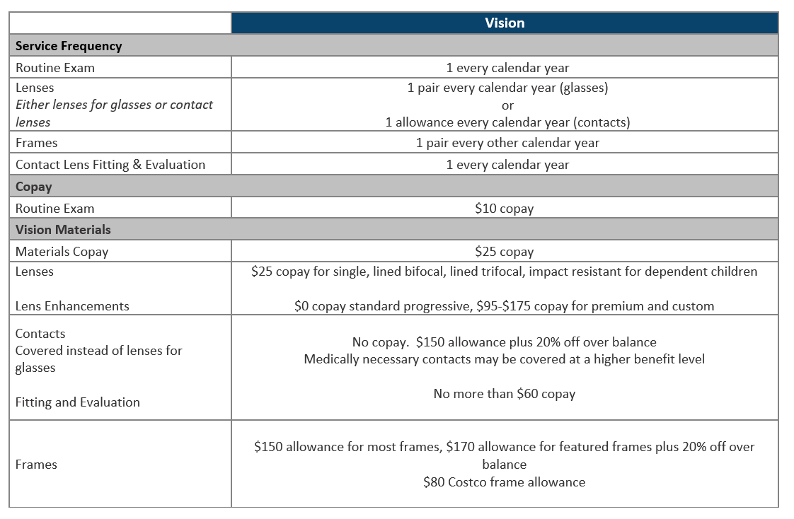
Vision Plan Highlights

Slide 35
Vision Plan Network
Finding A Network Provider
You’ll find a listing of doctors at www.vsp.com, search VSP Choice Network
  Download the VSP mobile app
  Call VSP Member Services at (800) 877-7195
Go to www.vsp.com/offers for extra savings

Slide 36
Vision Plan Monthly Premiums
Small change in monthly premiums. Employee pays full premium
Tier Level | Employee Cost
Employee Only | $8.55
Employee + 1 | $12.39
Employee + 2+ | $22.22

Slide 37

Life & Disability Insurance

Slide 38
Short-Term Disability
Voluntary insurance that pays you a portion of your salary if you are unable to work due to a disabling illness, injury, or pregnancy.
Coverage is 100% employee paid and is available to staff only. You can design your benefit to meet your needs.
Benefit Amount:
  60% of your weekly base salary in increments of $10 up to $2,000 per week
Benefit Choices:
  Choice 1: Benefit begins on day 8 after an injury or sickness. Maximum benefit period is 12 weeks.
  Choice 2: Benefit begins on day 15 after an injury or sickness. Maximum benefit period is 11 weeks.
  Choice 3: Benefit begins on day 30 after an injury or sickness. Maximum benefit period is 9 weeks.
Notes:
Reference MN Paid leave may reduce the need.

Slide 39
Basic Life/AD&D and Long-Term Disability
Life and AD&D
Macalester College provides an employer paid life and accidental death and dismemberment (AD&D) benefit to all benefit eligible employees.
Employee Benefit
1 x base salary up to $500,000
Please be sure to review and update your beneficiary information as needed; does not have to be done during open enrollment.
LTD
The following highlights details regarding our long-term disability plan. This benefit is 100% employer paid.
Benefit Amount
60% of your monthly base salary (66.67% for members of collective bargaining unit) up to $10,000/month
Elimination Period
Benefits begin after a 90-day elimination period

Slide 40
Additional Coverages

Slide 41

Additional Coverages
Please see your Benefits Guide for additional information on:
Identity Theft Protection, Legal Plan, Retirement Plans, Time-Off Benefits, Employee Assistance Program (EAP), SAVI Student Loan Management, Dependent Tuition Assistance, 529 College Savings Plan, Long Term Care Insurance

Slide 42

Benefit Resource Center
Contact the USI Benefit Resource Center (BRC) for free, confidential help!
Help in determining which Macalester plan is best for you and your family
Questions on benefits
Claims assistance
Billing issues
Email: BRCMT@usi.com
Phone: (855) 874-0742
Monday - Friday
8:00am to 5:00pm

Slide 43
Enrollment Process

Slide 44

Key Dates
The Open Enrollment period is Friday, October 31 – Friday, November 14
All benefit elections and changes will take effect January 1, 2026

Slide 45
Key Information
Passive Enrollment
Must re-enroll in FSA
Must re-enroll in HSA
No changes unless QLE

Slide 46
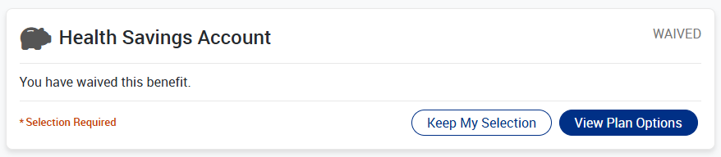
HSA Enrollment Requirement

Slide 47
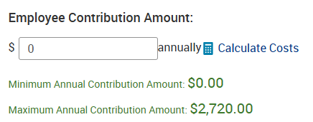
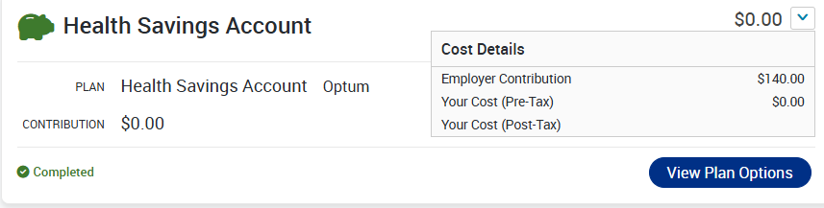
HSA Enrollment Requirement
Employee doesn’t want to make any contributions:
Will need to elect into the HSA
Enter in $0
Will set up the employer contribution amount

Slide 48
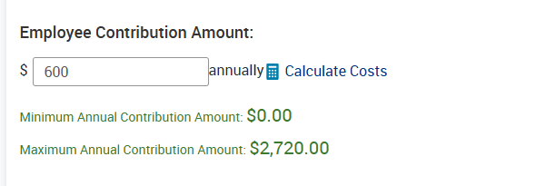
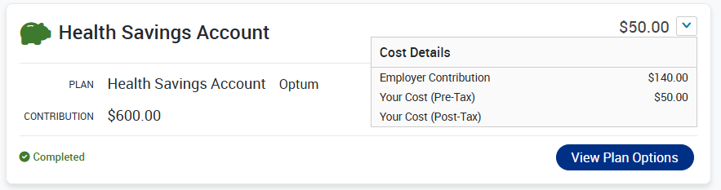
HSA Enrollment Requirement
Employee wants to make their own contribution:
Will need to elect into the HSA
Enter in the annual contribution you’d like to make
Will set up the employer contribution amount
Notes:
In this example, the employee does want to make additional employee contributions on top of receiving Macalester’s contributions.
The employee will need to enter in the annual amount they want to contribute, and this example, that’s $600. They will then need to save that election. This allows both the employee and employer contribution to be set up.
We can see that the employees cost is $50/month and the employer contribution is $140/month.
We will be auditing all HDHP enrollees to ensure that HSA elections are made so that the employer contribution is set up. If you have any questions while enrolling please feel free to reach out to myself, Stacy Peterson or HR@macalester.edu

Slide 49



Wellness & Health at Macalester
Kelly Fang (she/her)
Senior Well-being Program Manager
NBHWC Certified Health & Well-being Coach
WHAM Co-Chair

Slide 50


CONGRATULATIONS
1st Administration & Finance: 2,275
2nd Information Technology Services: 1,155
3rd Student Affairs: 1,059
4th Academic Affairs: 737
5th Advancement: 672
6th Admissions & Financial Aid: 543
7th Institutional Equity: 491
Macalester’s TOTAL: 6,932 minutes (115 hours)

Slide 51

WELL-BEING REWARD REMINDER
Deadline October 31, 2025

Slide 52

2025 Well-being Reward
Employee and Spouse/Partner can each earn their own reward
Activity
Health assessment
Activity
Mastercard
$150
1
Employee
1
2
1234 5678 9101 2345
3
YOUR NAME HERE
2
Activity
Health assessment
Activity
Mastercard
$150
1
Spouse
Or Partner
3
2
1234 5678 9101 2345
3
YOUR NAME HERE

Slide 53

2025 HEALTH
ASSESSMENT
RESULTS
361 Completions as of Sept. 30
Data from
January – August 2025
N = 238 repeat participants

Slide 54
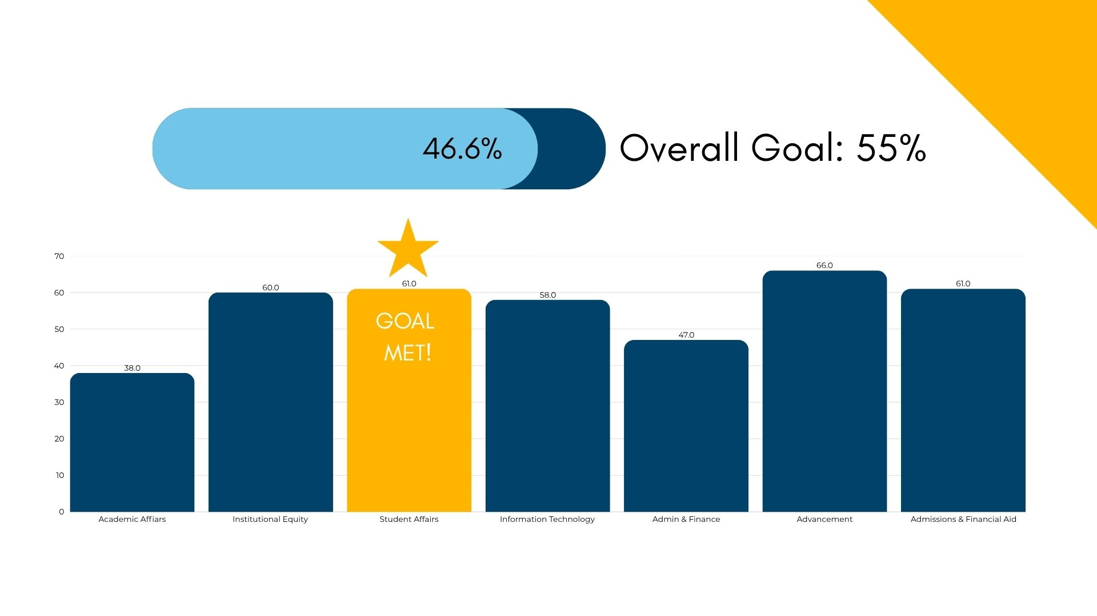
Health Assessment Completion

Slide 55
Diabetes & Heart Disease
DIAGNOSED WITH DIABETES INCREASED BY
0.3%
DIAGNOSED WITH HEART DISEASE DECREASED BY
O.4%

Slide 56
Depression, High Blood Pressure, High Cholesterol
DIAGNOSED WITH DEPRESSION INCREASED BY
0.8%
DIAGNOSED WITH HIGH BLOOD PRESSURE INCREASED BY
1.7%
DIAGNOSED WITH HIGH CHOLESTEROL INCREASED BY
3.3%

Slide 57
Fruit & Vegetables & Physical Activity
THOSE EATING FEWER THAN 5 SERVINGS OF FRUITS & VEGGIES EACH DAY INCREASED BY
1.7%
THOSE GETTING LESS THAN 150 MINUTES OF MODERATE OR 75 MINUTES OF VIGOROUS ACTIVITY EACH WEEK INCREASED BY
4.2%

Slide 58
Sleep & Alcohol
FEWER THAN 7 OR MORE THAN 9 HOURS OF SLEEP INCREASED BY
1.6%
MORE THAN 7 DRINKS (ALCOHOL) PER WEEK FOR WOMEN OR 14 FOR MEN DECREASED BY
2.1%

Slide 59
Physical Health & General Health
PHYSICAL HEALTH CONCERNS INTERFERE WITH DAILY LIFE DECREASED BY
1.2%
POOR GENERAL HEALTH DECREASED BY
O.4%

Slide 60

2025
FOCUS AREAS

Slide 61
Focus Areas
Fruits & Vegetables
Lunch & Learn: Colorectal Cancer Prevention
Heart Disease, Blood Pressure, Cholesterol
Physical Activity
Make a Move Challenge with Wellbeats
Nov-Dec: Mindful Drinking Group Coaching
November Lunch & Learn: Alcohol Use Screening & Interventions
Promote WHAM Classes
Nutrition Challenge or Group Coaching
Promote Go for Fruits & Veggies
Lunch & Learn: Heart Health
Promote 10,000 Steps®
Text

Slide 62


Slide 63






Three Group Sessions
Create Awareness and a Plan
Peer Wisdom and Support
Lower Blood Pressure and Cholesterol
SOBER CURIOUS?

Slide 64

WELL-BEING
ACTIVITIES

Slide 65
Review
Program components
Health Assessment
Macalester Specific Activities
Disease & Case Management
Tracking Activities
  10,000 Steps
  Sleep tracker
  Stress tracker
Digital Activities
  Choose to Lose
  Go for Fruits & Veggies
  Healthy Thinking
  Sugar Smart
  Tackle Stress
  Wellbeats
  Vape: Think Twice
  myStrength

Slide 66
Review
Macalester Specific Activities
  Health & Well-being Coaching
  Preventive Visit
  WHAM Activity Class
  Attend 3 WHAM Lunch and Learns
  Nice Healthcare Services
  Macalester’s 5K Run/Walk
  Leonard Center or Gym of Your Choice
  Personal Training with Nathan Downey
  EAP Wellness Seminars

Slide 67

Health & Well-being Coaching
Help identify your values and transform goals into action
Choose topics that are important to you and move towards your own vision of well-being
Mobilize your internal strengths and external resource
Achieve greater balance, create better boundaries and experience thriving!

Slide 68

For details visit:
macalester.edu/wham
On January 2, 2026, log on to:
healthpartners.com/livingwell

Slide 69
Thank you.
Please reach out to Randi Hartman, Stacy Peterson, or hr@macalester.edu with any questions.

